Slide 1

Introduction to Data Science and Analytics
(DSC510)
Handling Data
George Pallis
Notes:
[length: just about 1 minute over in total; first half: 50-55 min]

Slide 2
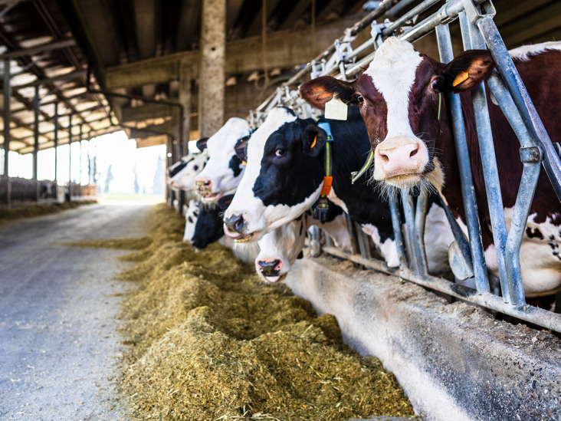
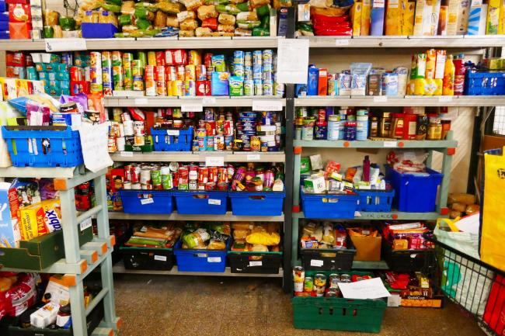


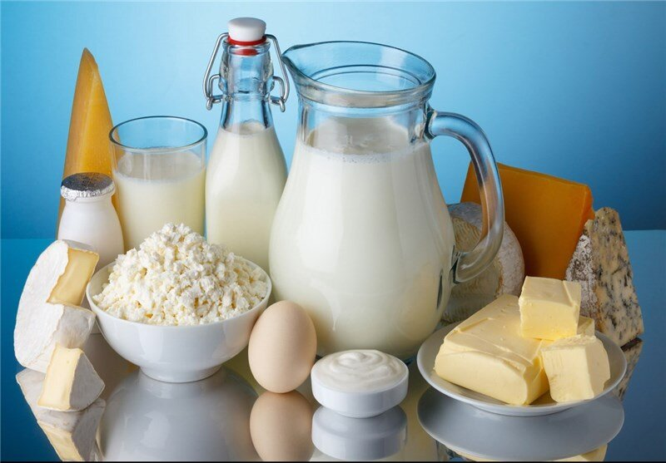
Cooking with data
Part 2:
Data sources
Part 1:
Data models
Part 3:
Data wrangling
Slides by Dr. Robert West, Applied Data Analysis

Slide 3
Cooking with data
Part 2:
Data sources
Part 1:
Data models
Part 3:
Data wrangling
Slides by Dr. Robert West, Applied Data Analysis

Slide 4
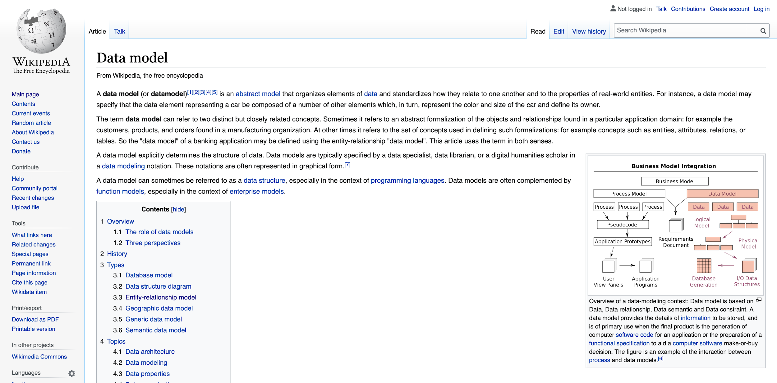
A data model specifies how you think about the world
Slides by Dr. Robert West, Applied Data Analysis

Slide 5
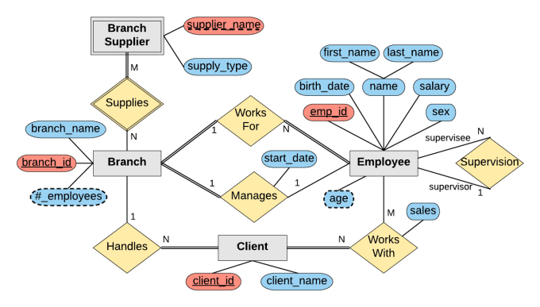
Q: “How do you think about the world?”
A: “See my entity–relationship diagram!”
How to store my data on a computer?
entity
Part 1:
Data models
relationship
attributes
Slides by Dr. Robert West, Applied Data Analysis
Notes:
A reminder from your DB class (prereq for ADA)
Gray rectangles: entities
Yellow rhombi: relationships (with cardinalities)
Blue/red pills: attributes (for both entities and relationships; red: keys)

Slide 6
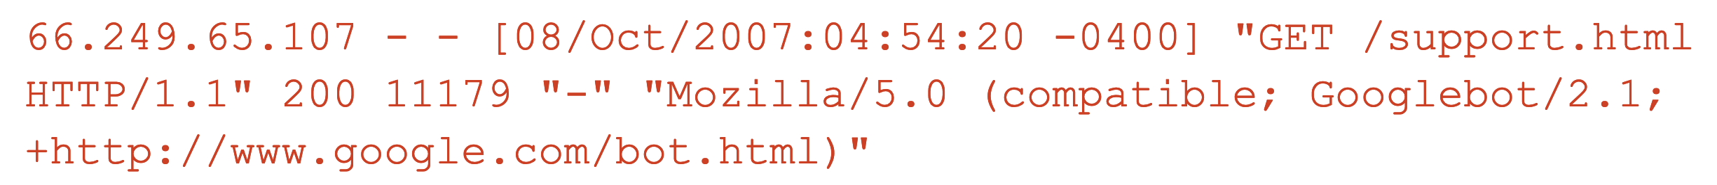
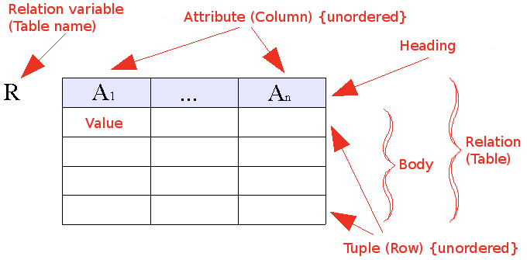
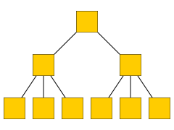
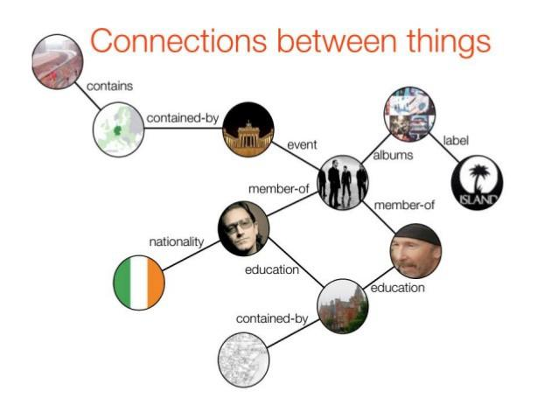
Q1: “How should I store my data on a computer?”
Q2: “How do I think about the world?”
“The world is simple: one type of entity, all with the same attributes” → Flat model
“The world contains many types of entities, connected by relationships” → Relational model
“The world is a hierarchy of entities” → Document model
“The world is a complex network of entities” → Network model
Slides by Dr. Robert West, Applied Data Analysis
Notes:
They are equivalent, can represent any dataset in any model
But processing the data is vastly simplified by representing the data in the most appropriate model

Slide 7
Flat model
Example: log files; e.g., Apache web server (httpd)
Entities = requests from clients to server
66.249.65.107 - - [08/Oct/2007:04:54:20 -0400] "GET /support.html HTTP/1.1" 200 11179 "-" "Mozilla/5.0 (compatible; Googlebot/2.1; +http://www.google.com/bot.html)"
111.111.111.111 - - [08/Oct/2007:11:17:55 -0400] "GET / HTTP/1.1" 200 10801 "http://www.google.com/search?q=in+love+with+ada+lovelace+what+to+do&ie=utf-8&oe=utf-8&aq=t&rls=org.mozilla:en-US:official&client=firefox-a" "Mozilla/5.0 (Windows; U; Windows NT 5.2; en-US; rv:1.8.1.7) Gecko/20070914 Firefox/2.0.0.7"
Another common format: CSV (“comma-separated vector”)
Slides by Dr. Robert West, Applied Data Analysis
Notes:
“d” in “httpd” for “daemon”
Not a real DB (no schema, no consistency), although it looks temptingly like one
~ benevolently formatted plain text

Slide 8
Q1: “How should I store my data on a computer?”
Q2: “How do I think about the world?”
“The world is simple: one type of entity, all with the same attributes” → Flat model
“The world contains many types of entities, connected by relationships” → Relational model
“The world is a hierarchy of entities” → Document model
“The world is a complex network of entities” → Network model
Slides by Dr. Robert West, Applied Data Analysis

Slide 9
Relational model
“The world contains many types of entities, connected by relationships”
The relational model is ubiquitous:
MySQL, PostgreSQL, Oracle, DB2, SQLite, …
You use it many times every day
Data represented as tables (“relations”) describing
entities,
relationships between entities
Most of the data we will use can be “reduced” to the relational model
id | name
1 | Bush
2 | Trump
3 | Obama
president | successor
1 | 3
3 | 2
Slides by Dr. Robert West, Applied Data Analysis
Notes:
(you’re supposed to know this as a prereq)

Slide 10
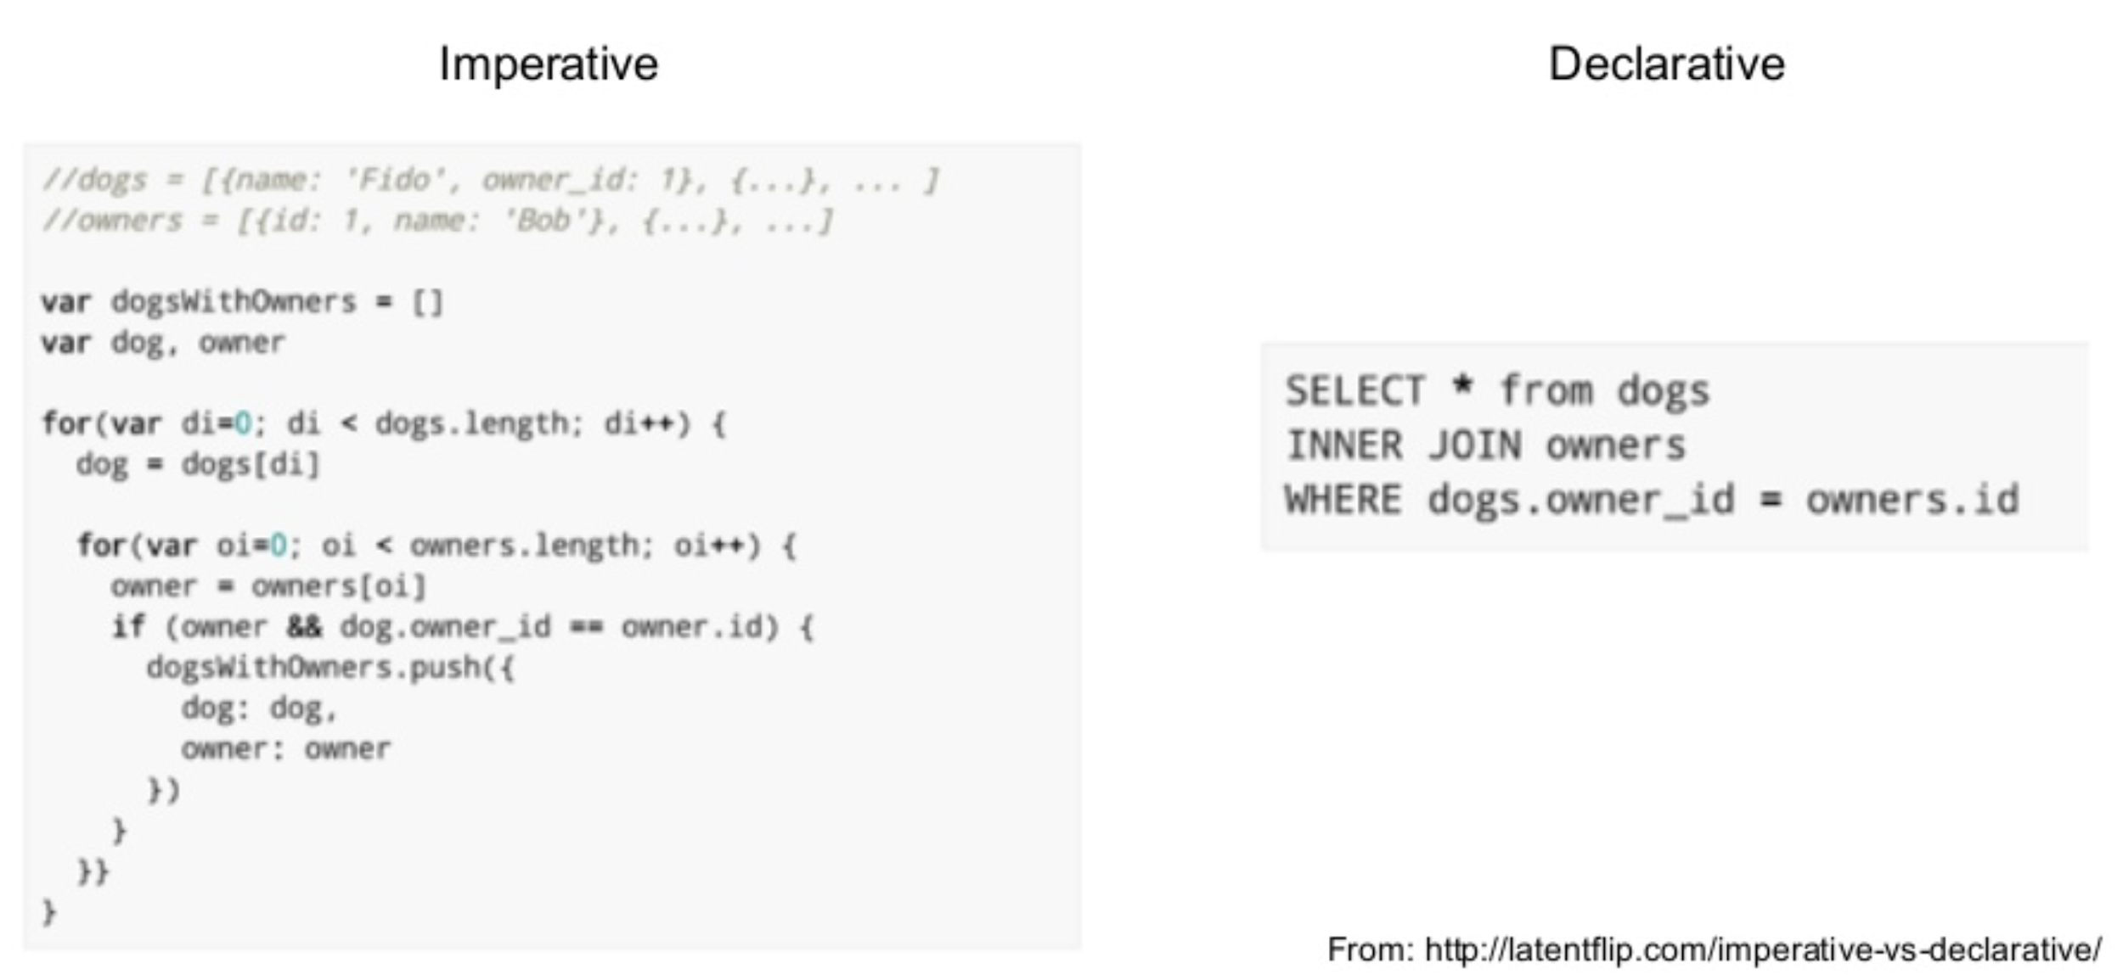
Processing data in the relational model: SQL
Declarative language for core data manipulations
You think about what you want, not how to compute it
Slides by Dr. Robert West, Applied Data Analysis
Notes:
SQL = structured query language
The interface for doing stuff with relational data
Extremely rich language; a lot of fun to puzzle together massive queries

Slide 11
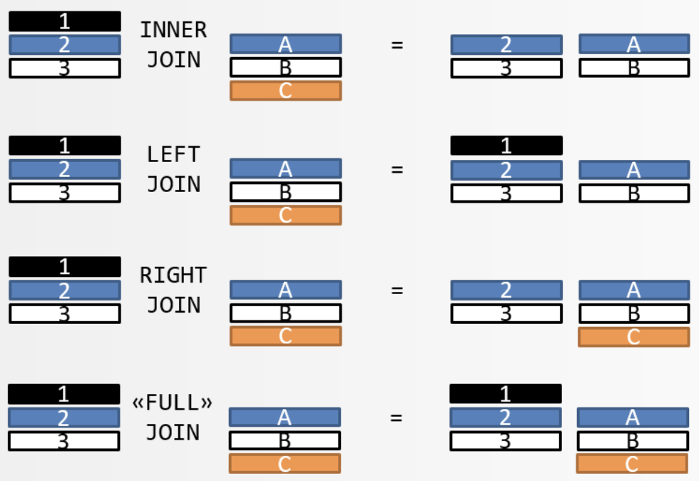
SQL
Need a refresher? → Watch/do online tutorials!
Key concepts:
Select (!), update, delete
Unique keys
Joins (inner, left outer, right outer, full)
Sorting
Aggregation (group by, count, min, max, avg, etc.)
Slides by Dr. Robert West, Applied Data Analysis
Notes:
POLL: Have you worked with SQL joins?

Slide 12
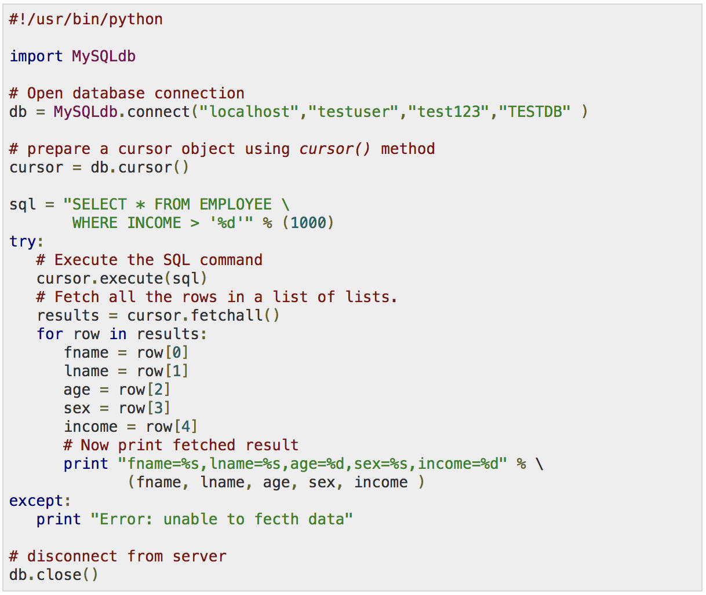


SQL implementations
etc.
Slides by Dr. Robert West, Applied Data Analysis
Notes:
There are command line clients and GUIs
but often most convenient: call from another PL (e.g., Python)

Slide 13
SQL and “SQL”
The declarative-programming principles of SQL are widespread, even where it’s less obvious
Slides by Dr. Robert West, Applied Data Analysis

Slide 14
“SQL”: Pandas (Python library)
Similar to SQL (declarative), with additional elements of functional programming (map(), filter(), etc.)
SQL “table” ←→ Pandas “DataFrame”
Slides by Dr. Robert West, Applied Data Analysis

Slide 15
Pandas vs. SQL
+ Pandas is lightweight and fast.
+ Natively Python, i.e., full SQL expressiveness plus the expressiveness of Python, especially for function evaluation.
+ Integration with plotting functions like Matplotlib.
- In Pandas, tables must fit into memory.
- No post-load indexing functionality: indices are built when a table is created.
- No transactions, journaling, etc. (matters for parallel applications)
- Large, complex joins are slower.
Slides by Dr. Robert West, Applied Data Analysis

Slide 16
Q1: “How should I store my data on a computer?”
Q2: “How do I think about the world?”
“The world is simple: one type of entity, all with the same attributes” → Flat model
“The world contains many types of entities, connected by relationships” → Relational model
“The world is a hierarchy of entities” → Document model
“The world is a complex network of entities” → Network model
Slides by Dr. Robert West, Applied Data Analysis

Slide 17
Document model
contact
address
“The world is a hierarchy of entities”
street,
city,
country
XML format:
JSON format:
<contact> <id>656</id> <firstname>Chuck</firstname> <lastname>Smith</lastname> <phone>(123) 555-0178</phone> <phone>(890) 555-0133</phone> <address> <street>Rue de l’Ale 8</street> <city>Lausanne</city> <zip>1007</zip> <country>CH</country> </address> </contact>
contact: { id: 656, firstname: “Chuck”, lastname: “Smith”, phones: [“(123) 555-0178”, “(890) 555-0133”], address: { street: “Rue de l’Ale 8”, city: “Lausanne”, zip: 1007, country: “CH” } }
Slides by Dr. Robert West, Applied Data Analysis
Notes:
Both formats equivalent
JSON usually easier to read for humans
XML: nested tags
JSON: set of key/value pairs
Keys: strings
Values:
Leaves: primitive types: strings, number, boolean
JSON object (recursive! → tree), e.g., “address”
Arrays of JSON objects (or strings/numbers/booleans)

Slide 18
Think for 1 minute:
If we want to use a relational DB (e.g., MySQL)
instead of XML, how can we store
2 phone numbers for the same person?
Document model
<contact> <id>656</id> <firstname>Chuck</firstname> <lastname>Smith</lastname> <phone>(123) 555-0178</phone> <phone>(890) 555-0133</phone> <address> <street>Rue de l’Ale 8</street> <city>Lausanne</city> <zip>1007</zip> <country>CH</country> </address> </contact>
Slides by Dr. Robert West, Applied Data Analysis

Slide 19
Solution to puzzle
Document model
Same in relational model
<contact> <id>656</id> <firstname>Chuck</firstname> <lastname>Smith</lastname> <phone>(123) 555-0178</phone> <phone>(890) 555-0133</phone> <address> <street>Rue de l’Ale 8</street> <city>Lausanne</city> <zip>1007</zip> <country>CH</country> </address> </contact>
id | first name | ...
656 | Chuck | ...
... | ... | ...
id | phone
656 | (123) 555-0178
656 | (890) 555-0133
... | ...
Slides by Dr. Robert West, Applied Data Analysis
Notes:
Relational: same entity may be spread across tables
doc model: all together
by allowing for repetitions, whereas in relational model, we can’t have a variable #cols
Different models are better suited for different kinds of processing
E.g., updating easier in doc model, since not spread out
Relationships between different entities more easily expressed in relational model (surprise…)

Slide 20
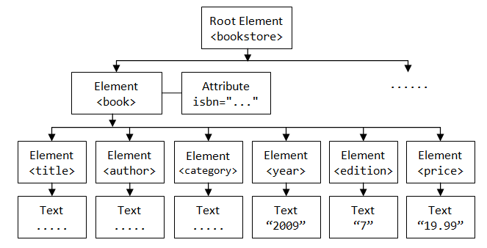
Processing XML and JSON
Document structure = tree
Processing via tree traversal (depth- or breadth-first search)
Or use proper query language, such as implemented by jq
Slides by Dr. Robert West, Applied Data Analysis

Slide 21
Q1: “How should I store my data on a computer?”
Q2: “How do I think about the world?”
“The world is simple: one type of entity, all with the same attributes” → Flat model
“The world contains many types of entities, connected by relationships” → Relational model
“The world is a hierarchy of entities” → Document model
“The world is a complex network of entities” → Network model
Slides by Dr. Robert West, Applied Data Analysis

Slide 22
Network model
“The world is a complex network of entities”
Slides by Dr. Robert West, Applied Data Analysis
Notes:
Model =~ how you think about the world
Models data as vertices and edges
Could also be written as tables as in relational model
But network model additionally comes with query language that lets you succinctly express graph relations
E.g., find path between Ireland and Island Records
(impossible in SQL)
We’ll see example later (Wikidata KG)

Slide 23
“How should I store my data on a computer?”
—A word (or two) on binary formats
Binary format often the key to performance, avoiding expensive parsing
Modern binary formats support nested structures, various levels of schema enforcement, compression, etc.
Python pickle, Java Serializable, Protocol Buffers (Google), Avro (supports schema evolution), Parquet (column-oriented), etc.
→ Consider converting to a binary format at the beginning of your processing pipeline (especially when using “big data”)
Slides by Dr. Robert West, Applied Data Analysis

Slide 24
Cooking with data
Part 2:
Data sources
Part 1:
Data models
Part 3:
Data wrangling
Slides by Dr. Robert West, Applied Data Analysis

Slide 25
Data sources at Web companies
Examples from Facebook
Application databases
Web server logs
Event logs
API server logs
Ad server logs
Search server logs
Advertisement landing page content
Wikipedia
Images and video
Structured data (with clear schema)
Semi-structured data
(“self-describing” structure; CSV etc.)
Unstructured data
Slides by Dr. Robert West, Applied Data Analysis
Notes:
(Order: structured → unstructured → semi-structured)
DB: constraints between tables, so everything is always nicely consistent
Cooking analogy: If you can go and pick ingredients from someone else’s shelves, or buy them in the store → great!
Much of the work done already by others
But when combining multiple sources, need to harmonize format → need to think about data models again
Sometimes need to go get your own data from the wild, unstructured world (→ we’ll quickly cover HTML scraping as an example)

Slide 26

Another example: Wikipedia
200+ languages
Over 50 million entities
Mind-boggling richness of data
Slides by Dr. Robert West, Applied Data Analysis

Slide 27
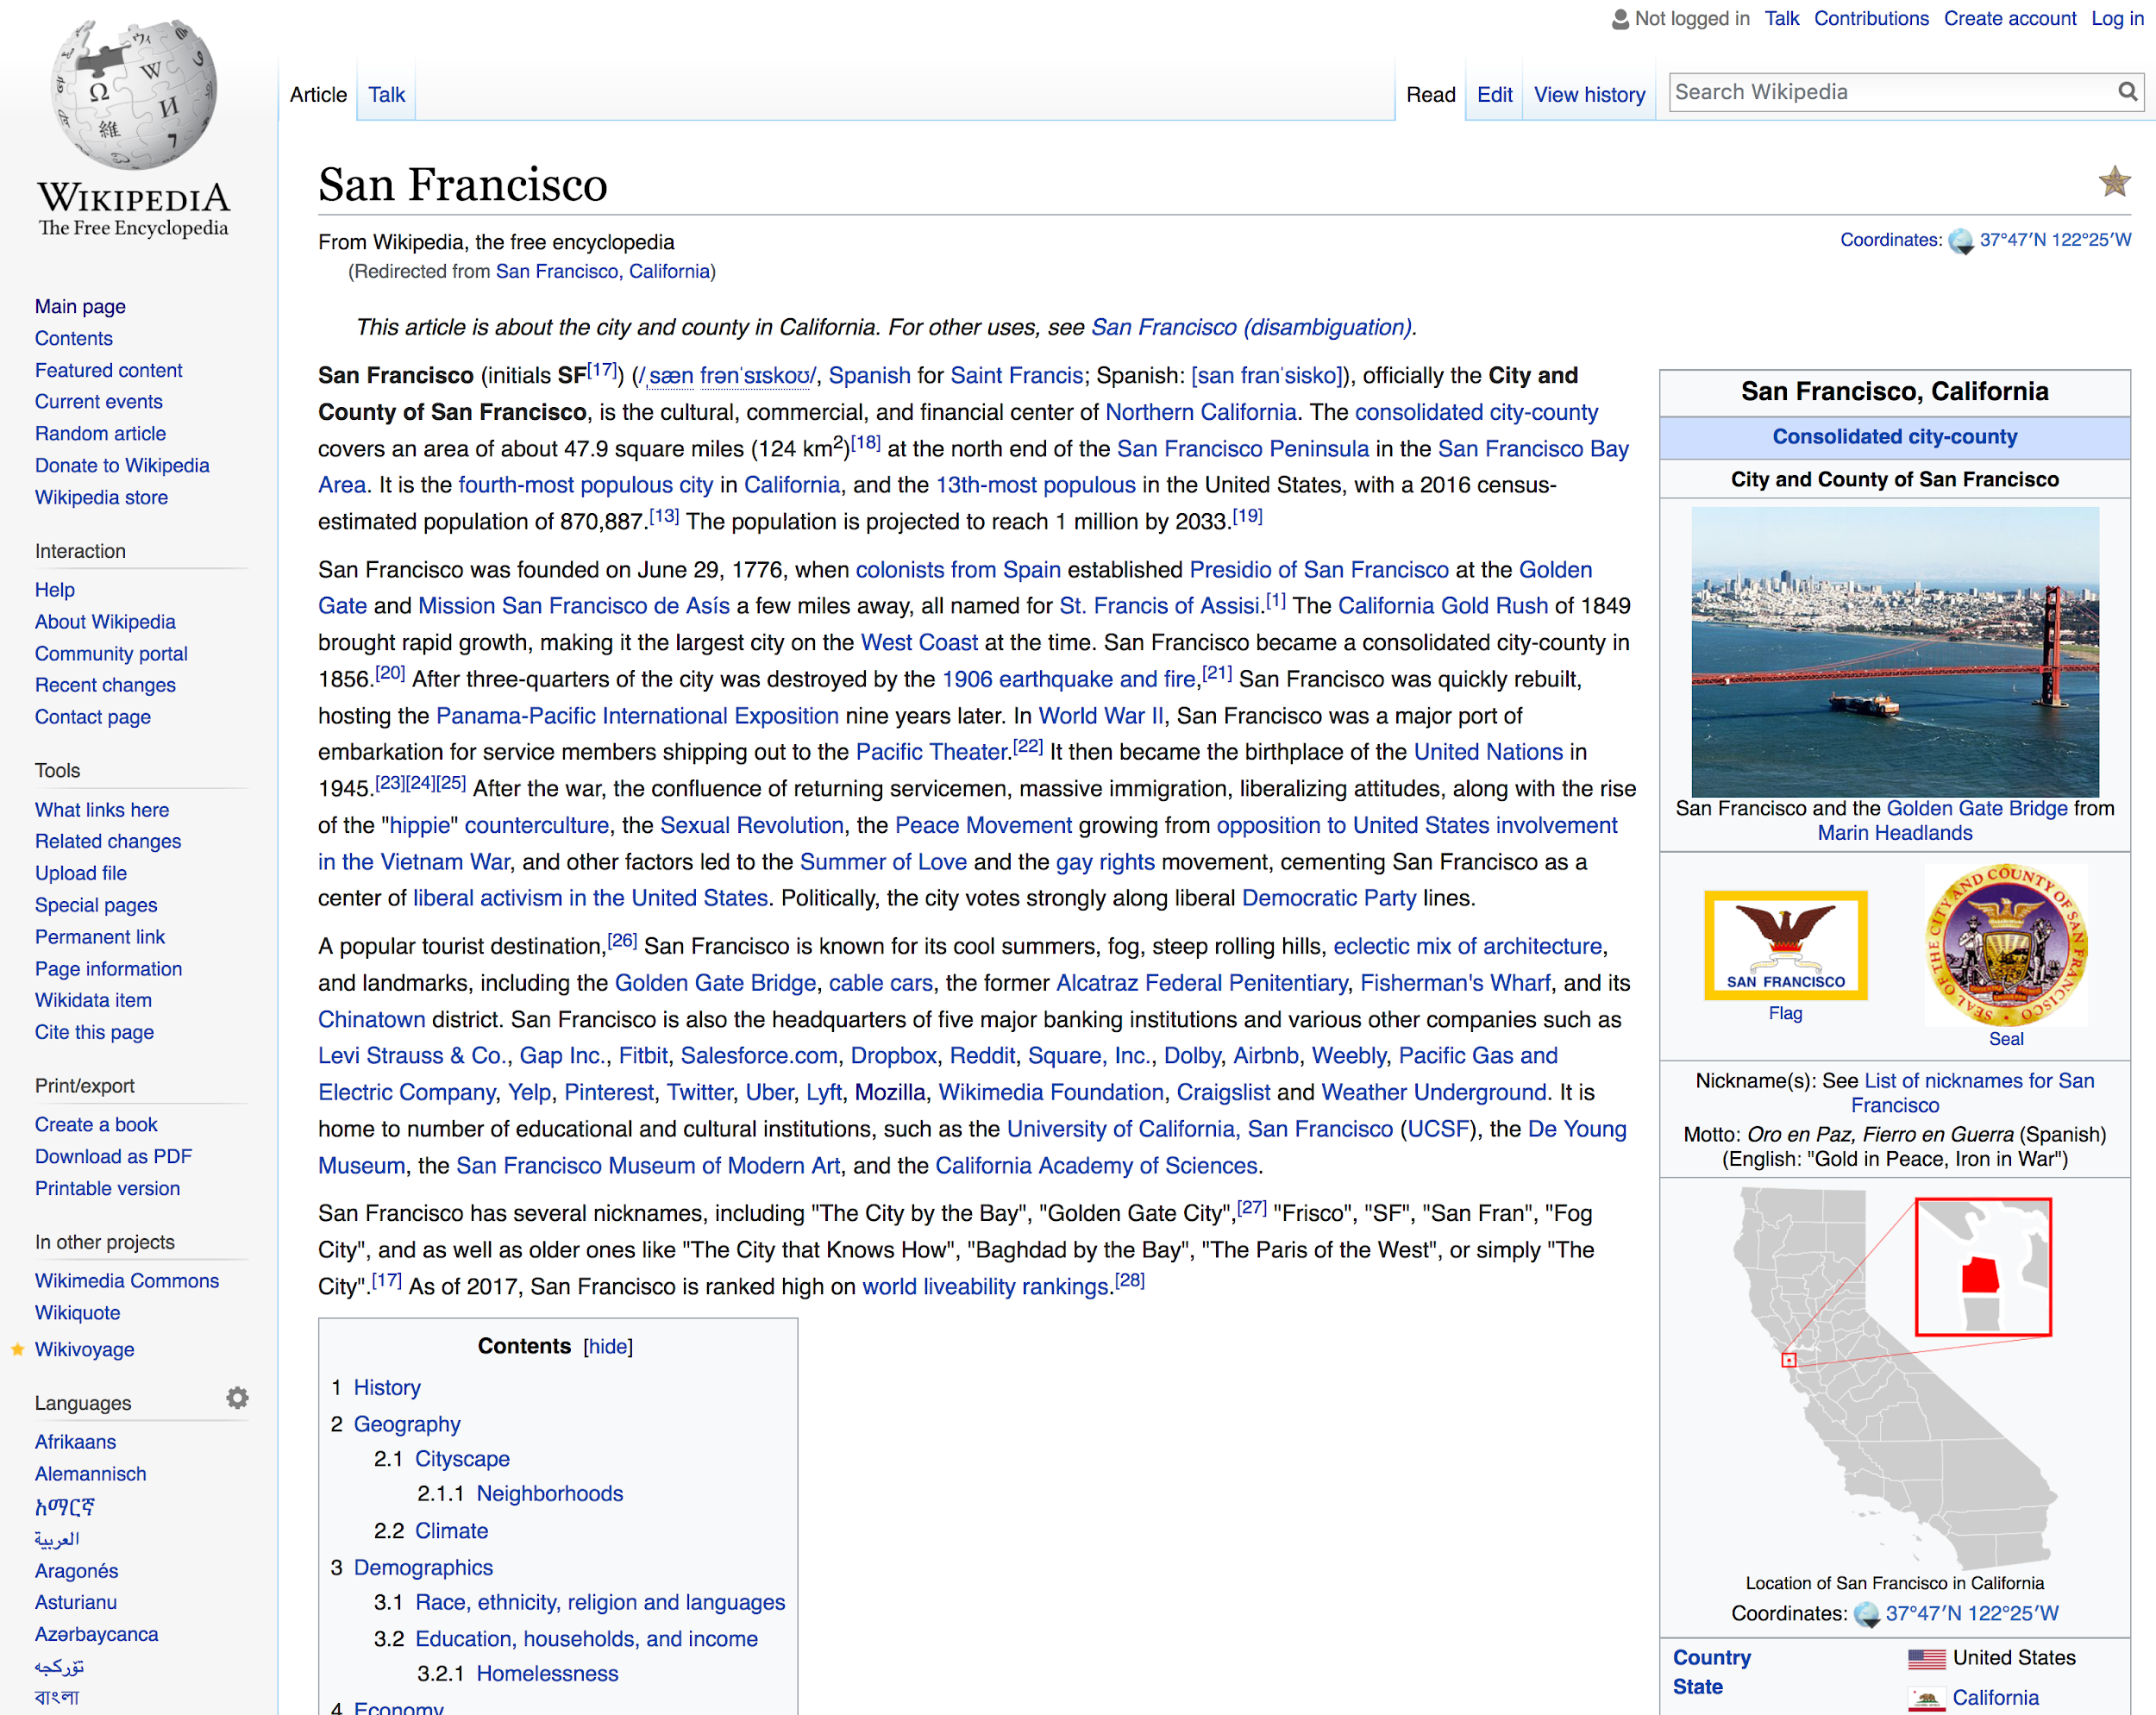
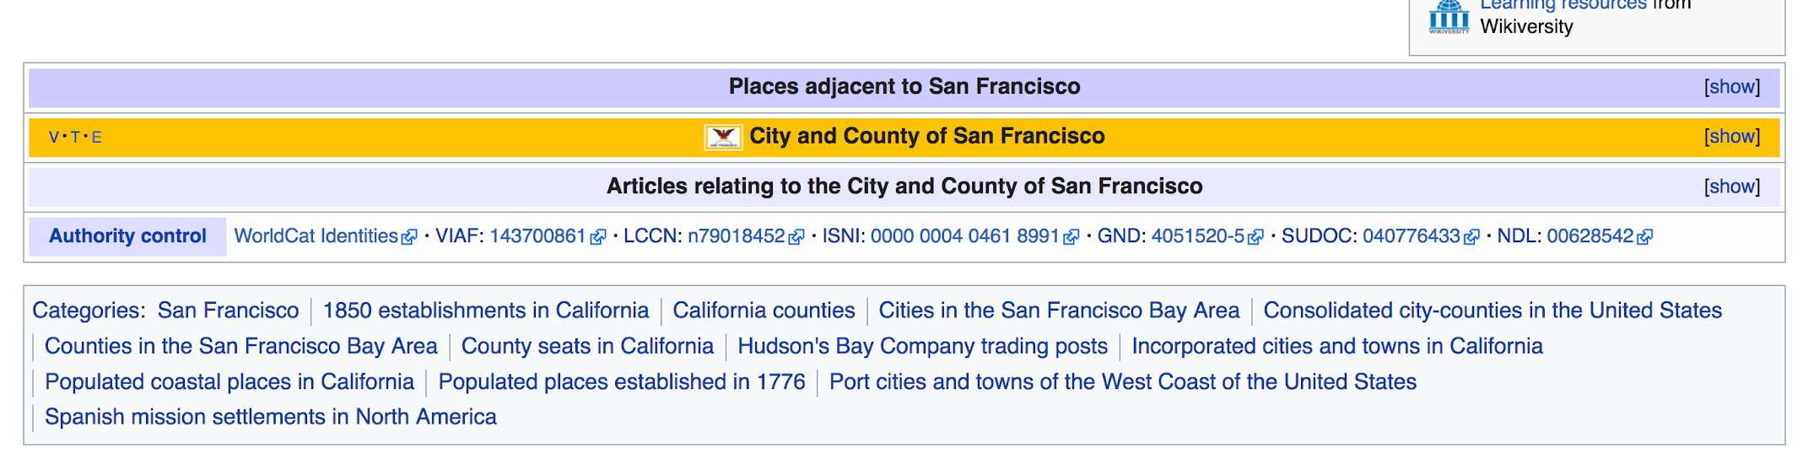
link
Slides by Dr. Robert West, Applied Data Analysis

Slide 28
Wikipedia
How to work with Wikipedia?
XML dumps with wiki markup, SQL database dumps
Issues: Unicode, size, recency, etc.
To make your life easier:
Find projects on GitHub to help you
Use more structured versions
Slides by Dr. Robert West, Applied Data Analysis

Slide 29
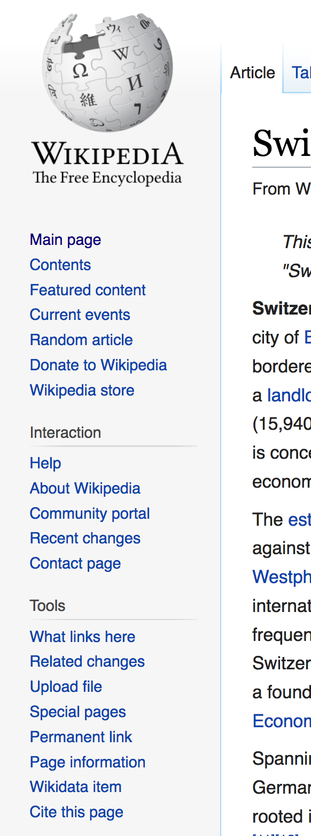
Wikidata
“Database version” of Wikipedia
{fr:Suisse, de:Schweiz, it:Svizzera, en:Switzerland, …} → Q39
Both API access and full database dumps
Available as
JSON (document model)
RDF (network model)
Slides by Dr. Robert West, Applied Data Analysis

Slide 30
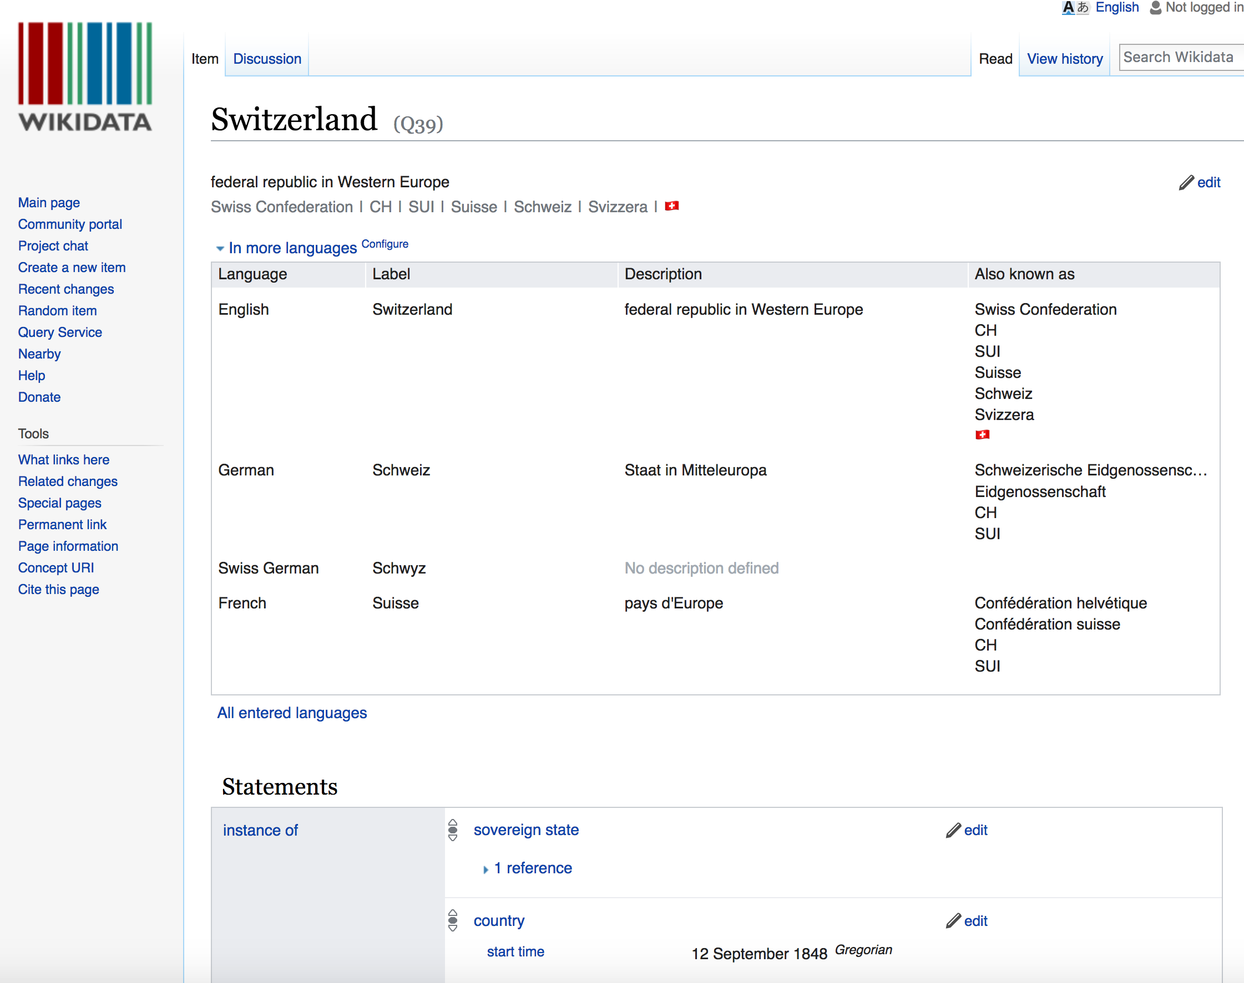

Slides by Dr. Robert West, Applied Data Analysis
Notes:
“Also known as”
Screenshot is HTML page
Here no need to bother about this fact, since info from page is available in much more easy-to-handle formats, e.g., JSON
(CLICK)
Not always the case: sometimes you need to bite the bullet and do “open-heart surgery” on raw HTML content

Slide 31
Crawling and processing webpages: HTML
Plenty of bulk-downloadable HTML data:
Common Crawl dataset, about 1.82 billion web pages -- huge!
(… but less than 0.1% of Google’s Web crawl, as of 2015)
145 TB, hosted on Amazon S3, also available for download
… but if you need a specific website: use a crawler/“spider”: Apache Nutch, Storm, Heritrix 3, Scrapy, etc. (or simply wget…)
Slides by Dr. Robert West, Applied Data Analysis
Notes:
(please don’t download to ADA cluster…)

Slide 32
Useful HTML tools
Requests http://docs.python-requests.org/en/master/
An elegant and simple HTTP library for Python
Scrapy https://scrapy.org/
An open-source framework to build Web crawlers
Beautiful Soup http://www.crummy.com/software/BeautifulSoup/ A Python API for handling real HTML
Plain ol’ /regular/expres*ion/s…
Slides by Dr. Robert West, Applied Data Analysis

Slide 33
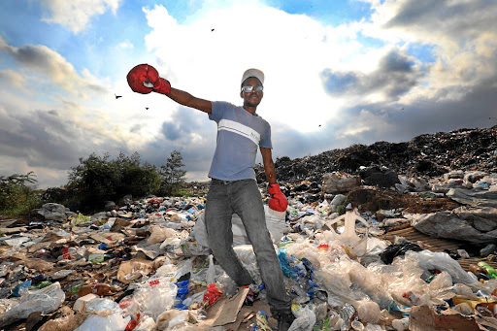
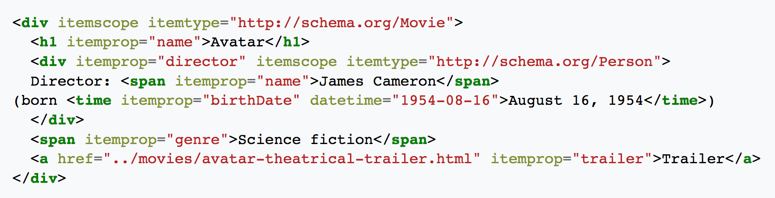
Schema.org: microformats for Web pages
Nuggets of structured information embedded in (semantically) unstructured HTML
Slides by Dr. Robert West, Applied Data Analysis
Notes:
“Sometimes you can find amazing things in the trash”

Slide 34
Web services
Most large web sites today actively discourage screen-scraping to get their content
Instead: Web service APIs, for interoperable machine-to-machine interaction over a network
The preferred way to get data from online sources
Most common framework: REST
You request a URL from the server via HTTP
The server responds with a text file (e.g., JSON, XML, plain text)
Slides by Dr. Robert West, Applied Data Analysis
Notes:
But a man gotta do what a man gotta do…

Slide 35
REST example
{
"user": {
"name": "Jane",
"gender": "female",
"location": {
"href": "http://www.example.org/us/ny/new_york",
"text": "New York"
}
}
}
← This resource is a description of a user named Jane
Requested by sending GET request for the resource’s URL, e.g., via curl: curl http://www.example.org/users/jane/
If they need to modify the resource, they GET it, modify it, and PUT it back
The href to the location resource allows savvy clients to get more information with another simple GET request
Implication: Clients cannot be too “thin”; need to understand resource formats!
Slides by Dr. Robert West, Applied Data Analysis

Slide 36
Cooking with data
Part 2:
Data sources
Part 1:
Data models
Part 3:
Data wrangling
Slides by Dr. Robert West, Applied Data Analysis

Slide 37
Working with raw data sucks
Data comes in all shapes and sizes – CSV files, PDFs, SQL dumps, .jpg, …
Different files have different formatting – Empty string or space instead of NULL, extra header rows, character encoding, …
“Dirty” data – Unwanted anomalies, duplicates
Slides by Dr. Robert West, Applied Data Analysis

Slide 38
Raw data without thinking:
A recipe for disaster!
Slides by Dr. Robert West, Applied Data Analysis
Notes:
(to stay within the cooking analogy)

Slide 39
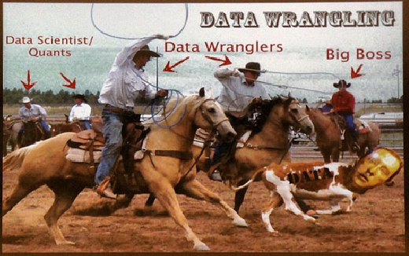
What is data wrangling?
Goal: extract and standardize the raw data
Combine multiple data sources
Clean data anomalies
Strategy: Combine automation with interactive visualizations to aid in cleaning
Outcome: Improve efficiency and scale of data importing
Slides by Dr. Robert West, Applied Data Analysis
Notes:
“Checks and balances”:
Automation to save you time and effort
Viz to see that you didn’t screw up

Slide 40
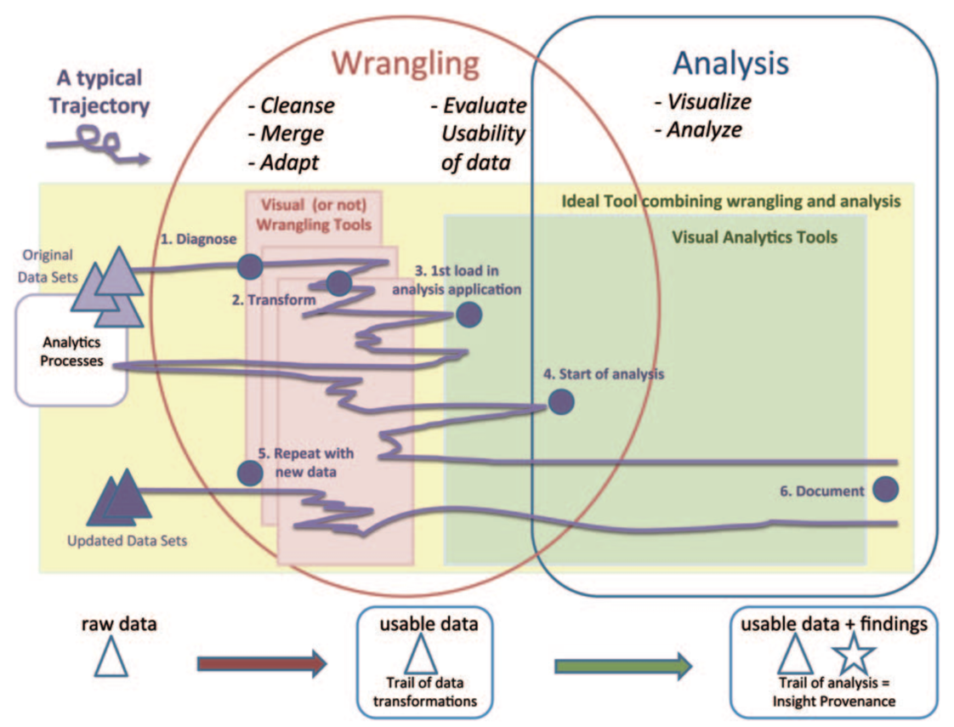
Wrangling takes between 50% and 80% of your time…
[Source]
Slides by Dr. Robert West, Applied Data Analysis
Notes:
Horrible plot to put in words
-- but that’s exactly the point
it’s extremely ad-hoc
there’s no perfect recipe
Need to use common sense!

Slide 41


Types of data problems
Missing data
Incorrect data
Inconsistent representations of the same data
About 75% of data problems require human intervention (e.g., experts, crowdsourcing, etc.)
Tradeoff between cleaning data vs. over-sanitizing data
link
Slides by Dr. Robert West, Applied Data Analysis

Slide 42
Diagnosing data problems
Visualizations and basic stats can convey issues in “raw” data
Different representations highlight different types of issues:
Outliers often stand out in the right kind of plot
Missing data will cause gaps or zero values in the right kind of plot
Becomes increasingly difficult as data gets larger
Sampling to the rescue!
Slides by Dr. Robert West, Applied Data Analysis
Notes:
HW1!

Slide 43
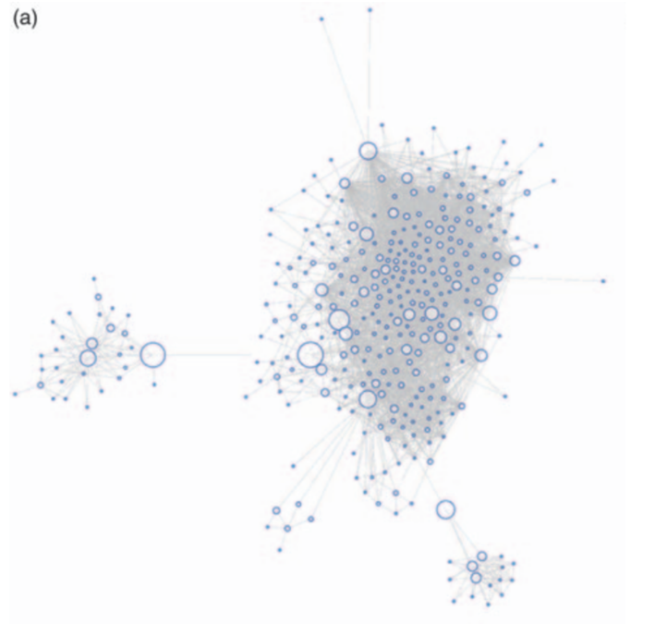
Facebook graph
Slides by Dr. Robert West, Applied Data Analysis

Slide 44
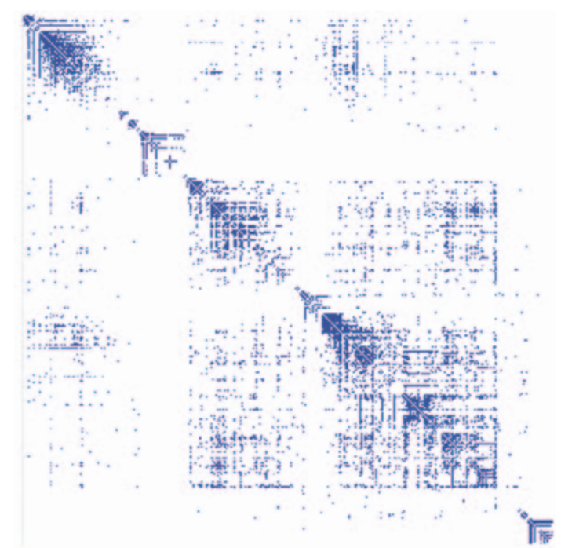
Matrix view (1)
Automatic permutation of rows and columns to highlight patterns of connectivity
Slides by Dr. Robert West, Applied Data Analysis
Notes:
Explain rows and columns
Ask: why is the matrix symmetric?

Slide 45
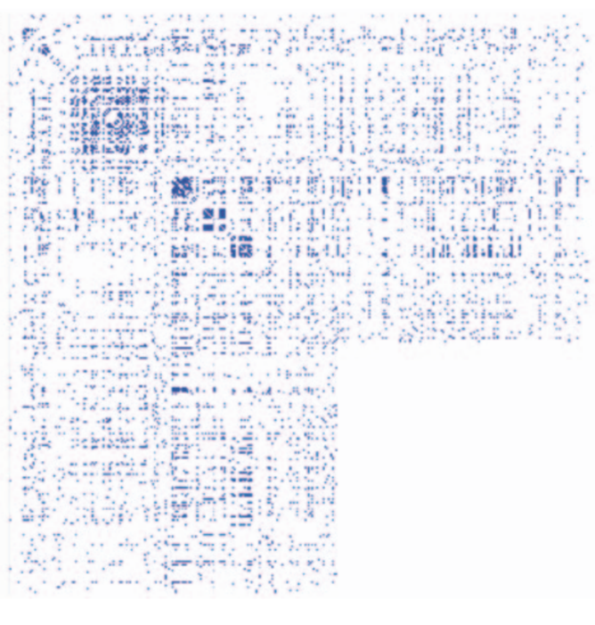
Matrix view (2)
Rows and columns sorted in the order in which data was retrieved via the Facebook API
Can you guess what’s going on here?
More info: http://vis.stanford.edu/files/2011-DataWrangling-IVJ.pdf
Slides by Dr. Robert West, Applied Data Analysis
Notes:
More info: http://vis.stanford.edu/files/2011-DataWrangling-IVJ.pdf

Slide 46
Think for 1 minute:
What causes the white block in the adjacency matrix?
Slides by Dr. Robert West, Applied Data Analysis
Notes:
Then: share

Slide 47
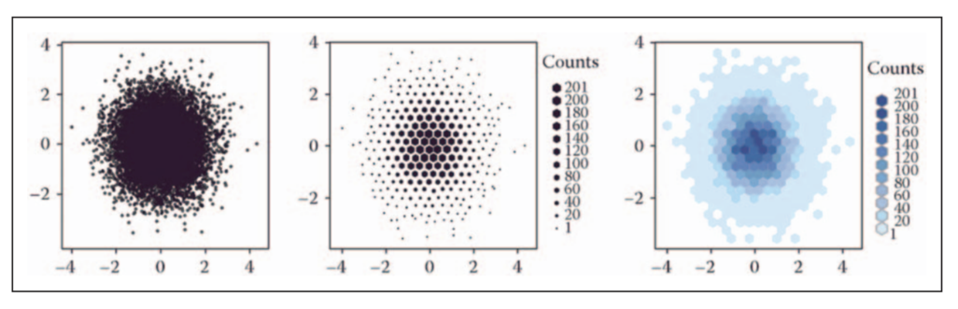
Viz at scale? Careful!
Slides by Dr. Robert West, Applied Data Analysis
Notes:
Hexagon vs. square
Color discontinuity: makes outlier spotting easier (no problem with middle plot here)

Slide 48
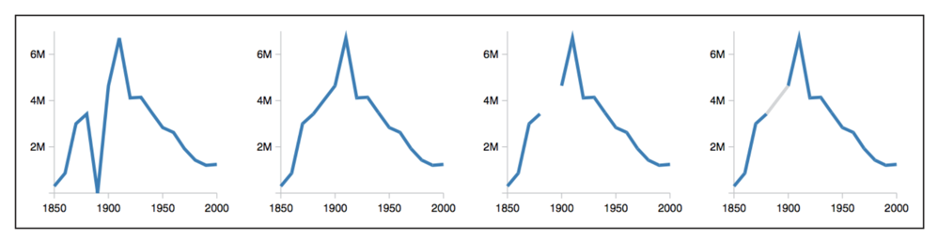
Dealing with missing data
U.S. census counts of people working as ‘‘farm laborers’’; values from 1890 are missing due to records being burned in a fire
Set values to zero?
Interpolate based on existing data?
Omit missing data?
Knowledge about domain and data collection should drive your choice!
Slides by Dr. Robert West, Applied Data Analysis

Slide 49
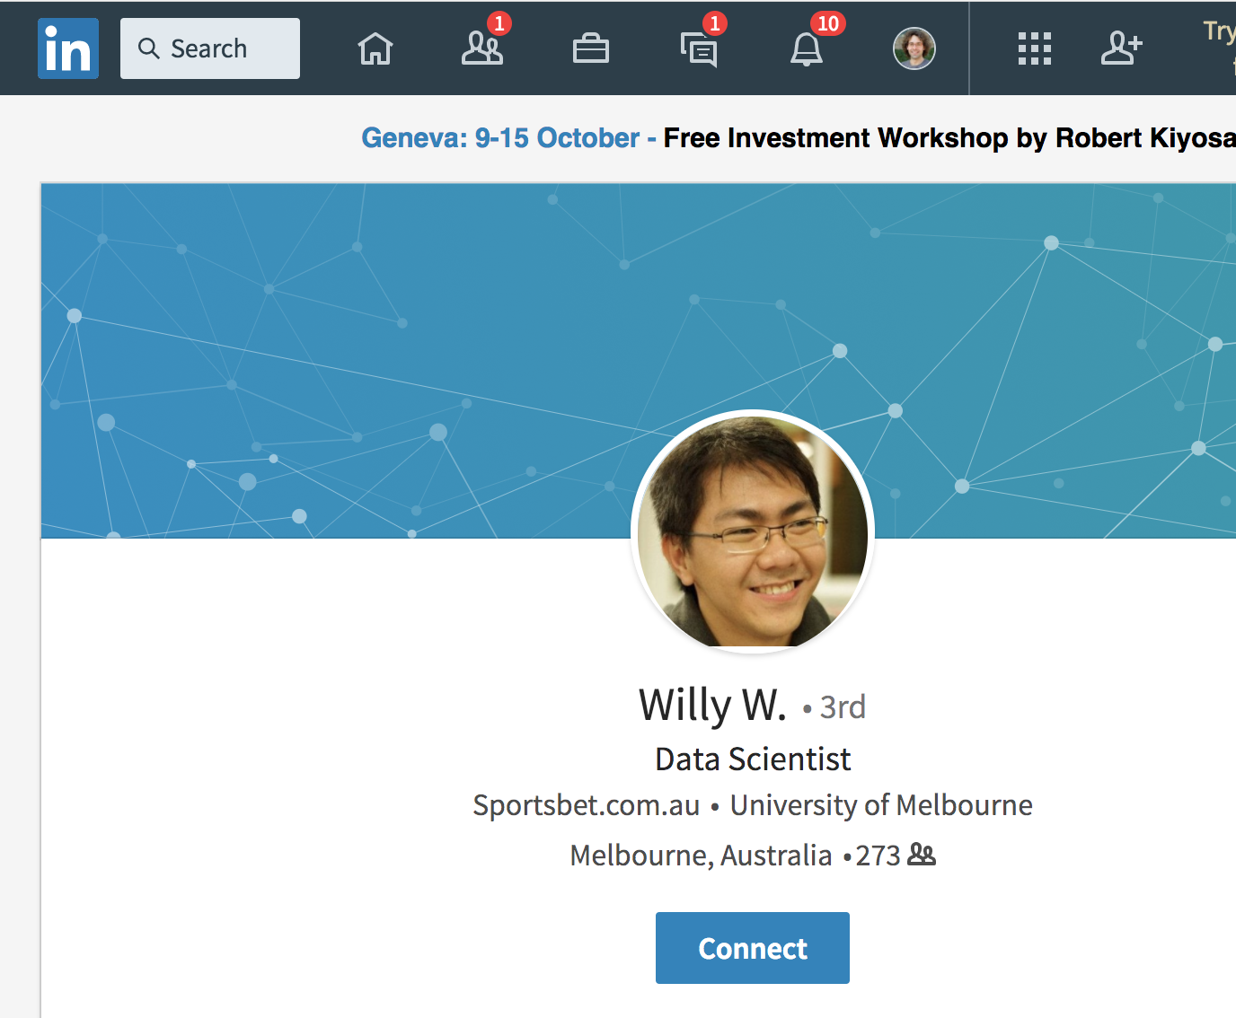
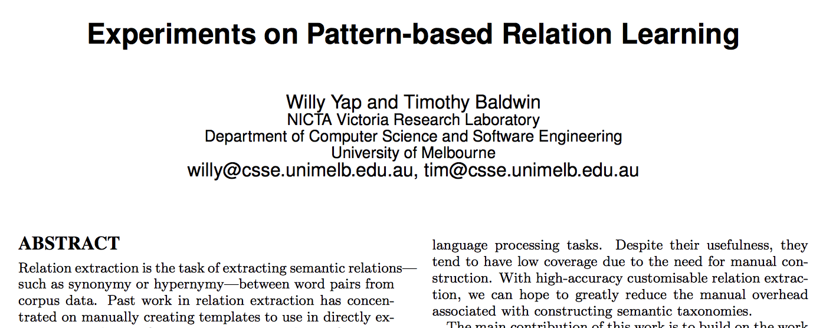
Inconsistent data: “My name is Willy”
First name | Last name
Willy | NULL
... | ...
Slides by Dr. Robert West, Applied Data Analysis
Notes:
I’m amazed how I even managed to find Willy via Google when making these slides
Luckily, Uni Melbourne is ok with first names for email addresses

Slide 50
Before you start analyzing your data
“Do I have missing data?” “If data were missing, how could I know?”
“Do I have corrupted data?” (May arise from measurement errors, wrong sampling strategies, etc.)
Parse/transform data into appropriate format for your specific analysis
Don’t be surprised if you need to come back to this stage!
Slides by Dr. Robert West, Applied Data Analysis
Notes:
This slide might be a “duh” moment, but people often forget these steps!

Slide 51
Desiderata – Things that are desired
It’s always ideal if you can put your hands on the code/documentation about the dataset you are analyzing (provenance)
It’s always ideal if the provided data format is nicely parseable (otherwise you need regexes, or maybe even pay humans)
Slides by Dr. Robert West, Applied Data Analysis

Slide 52
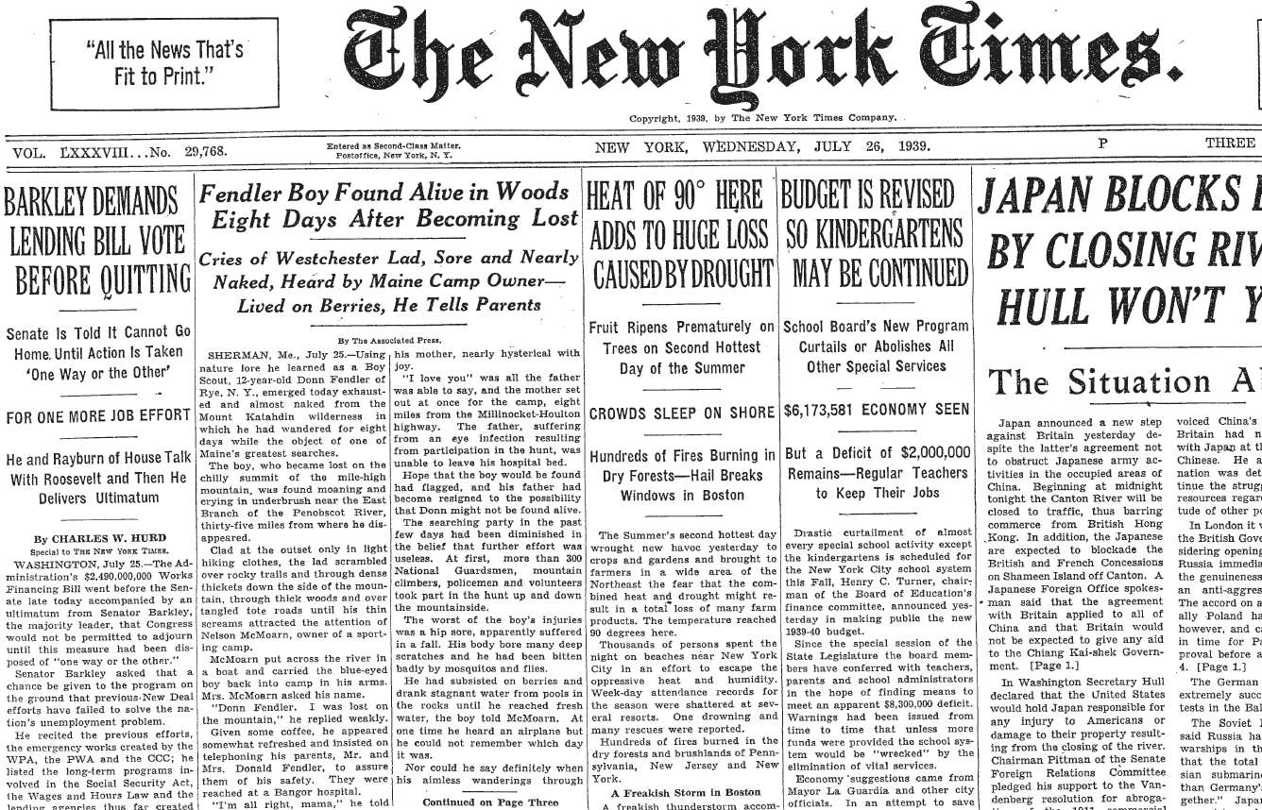

Highly non-parseable data
Entire NY Times archive (since 1851) digitized as of 2015
Slides by Dr. Robert West, Applied Data Analysis
Notes:
State-of-the-art OCR can’t do it
But humans can, so use it as a test of whether user is a human
(CAPTCHA = Completely Automated Public Turing test to tell Computers and Humans Apart)
Beauty: two birds with one stone: test + data
And when the system is compromised, everyone wins: OCR++
EXPLAIN:
Two words, one with known ground truth

Slide 53
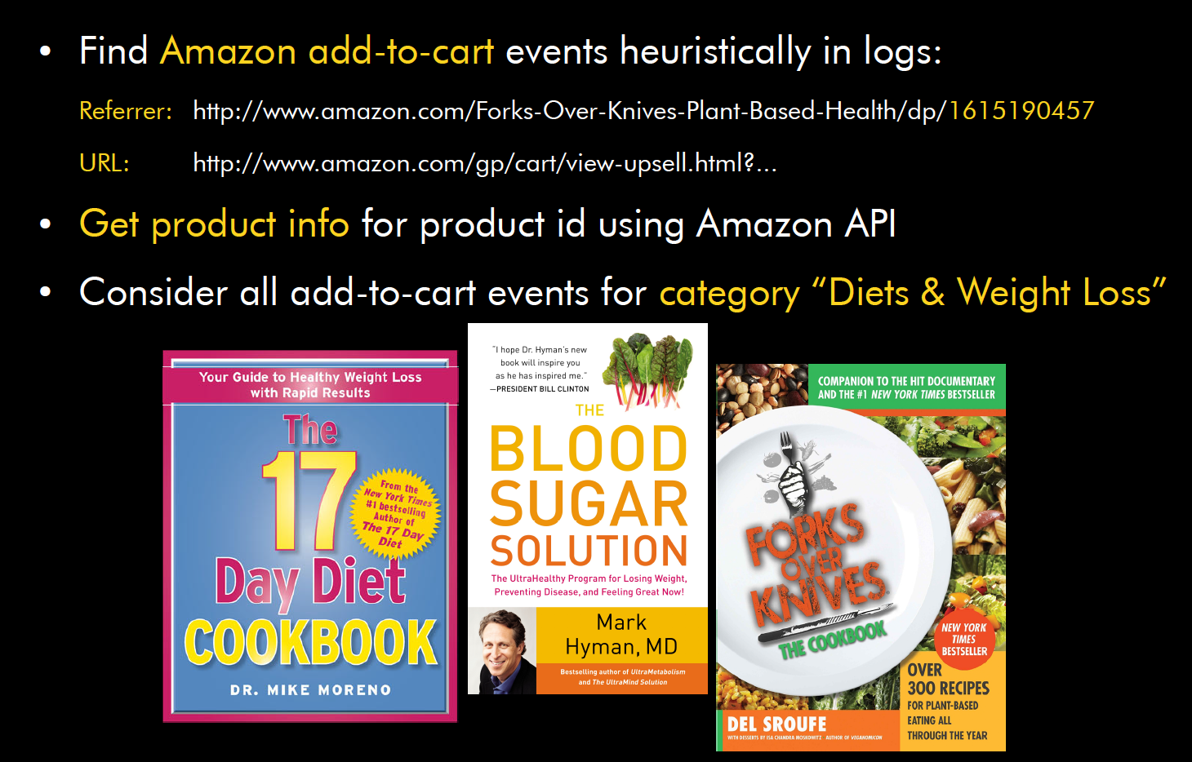
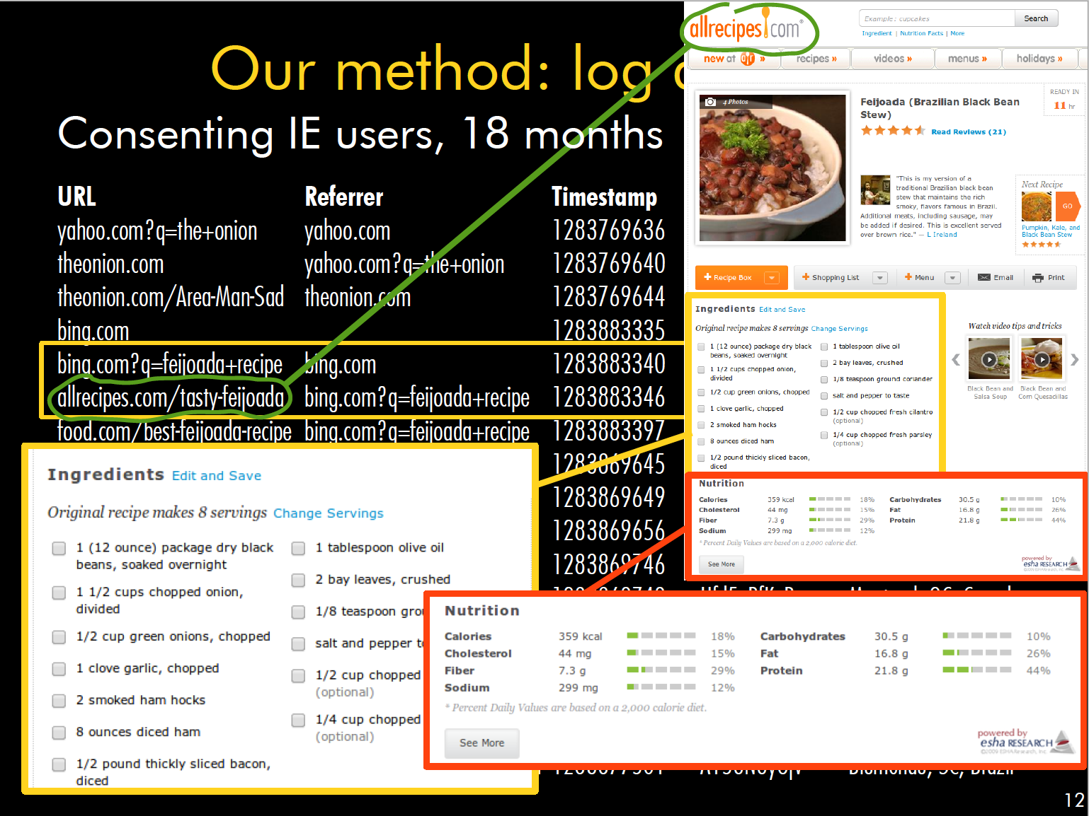
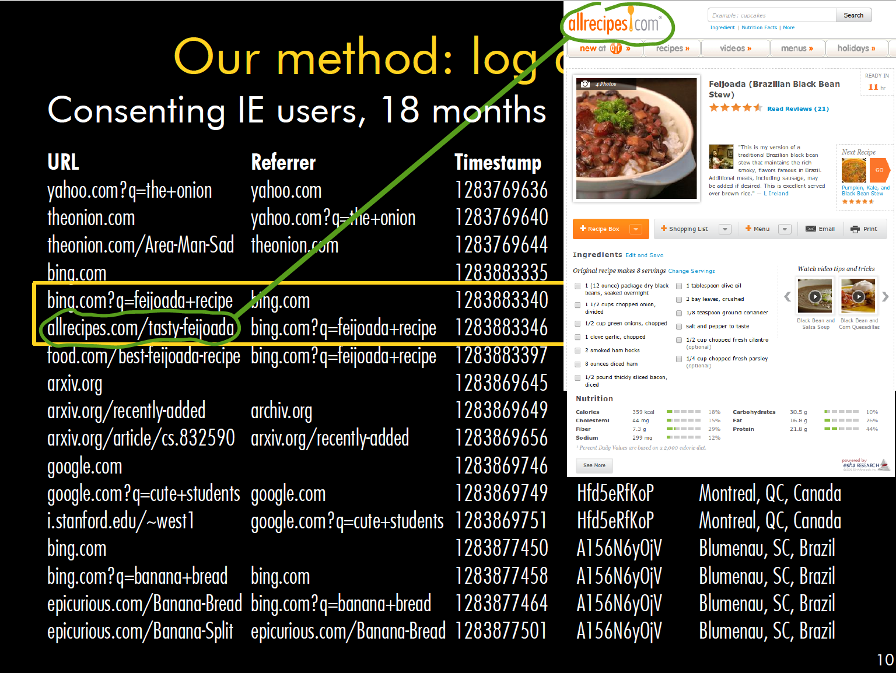
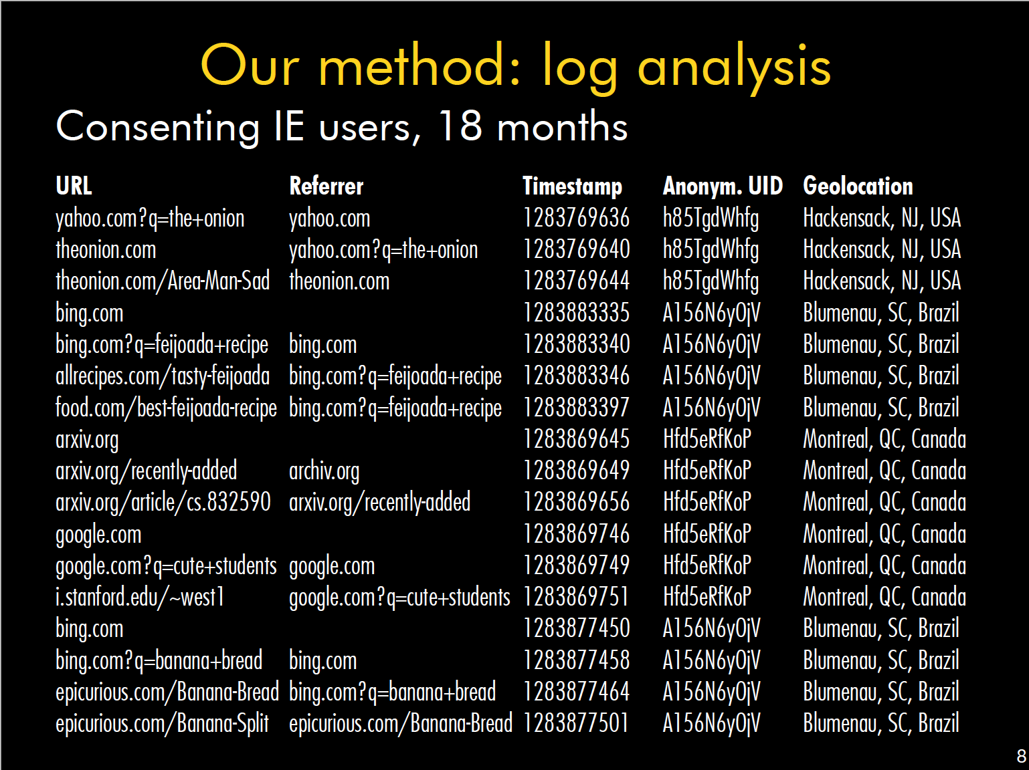
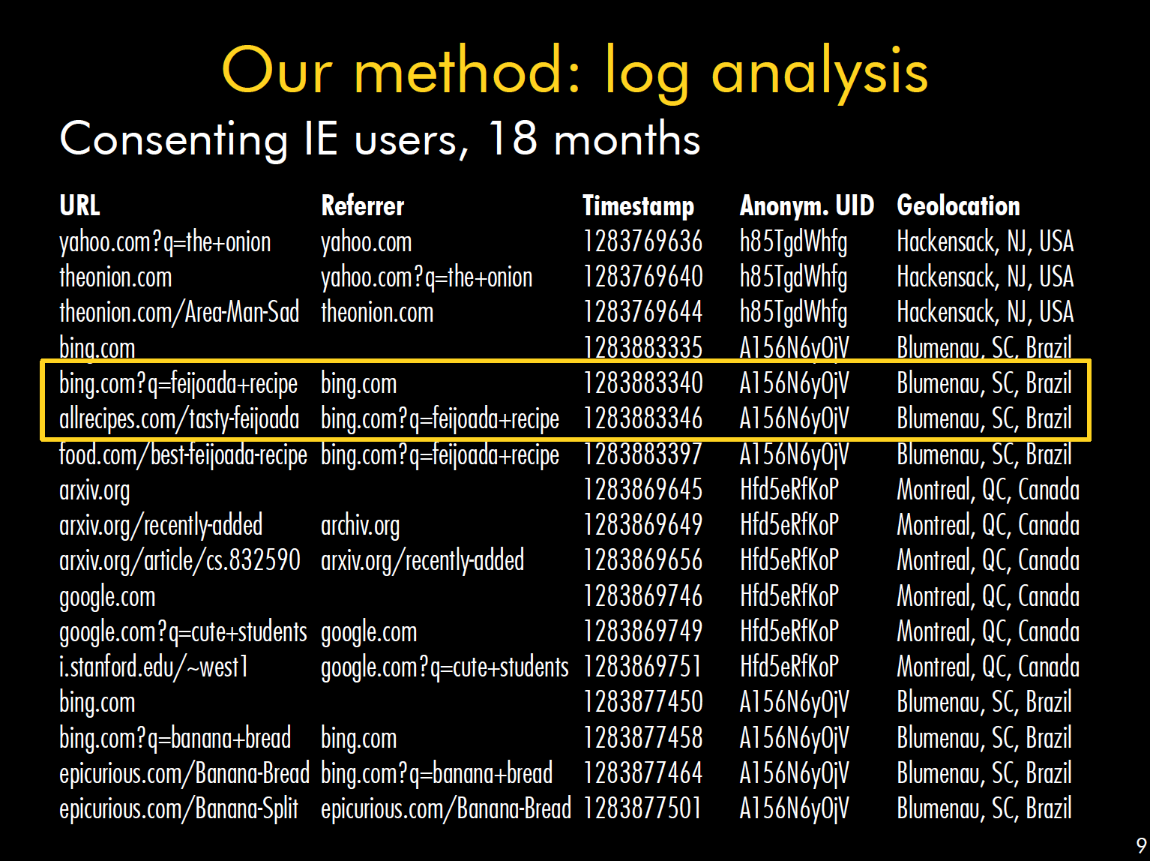
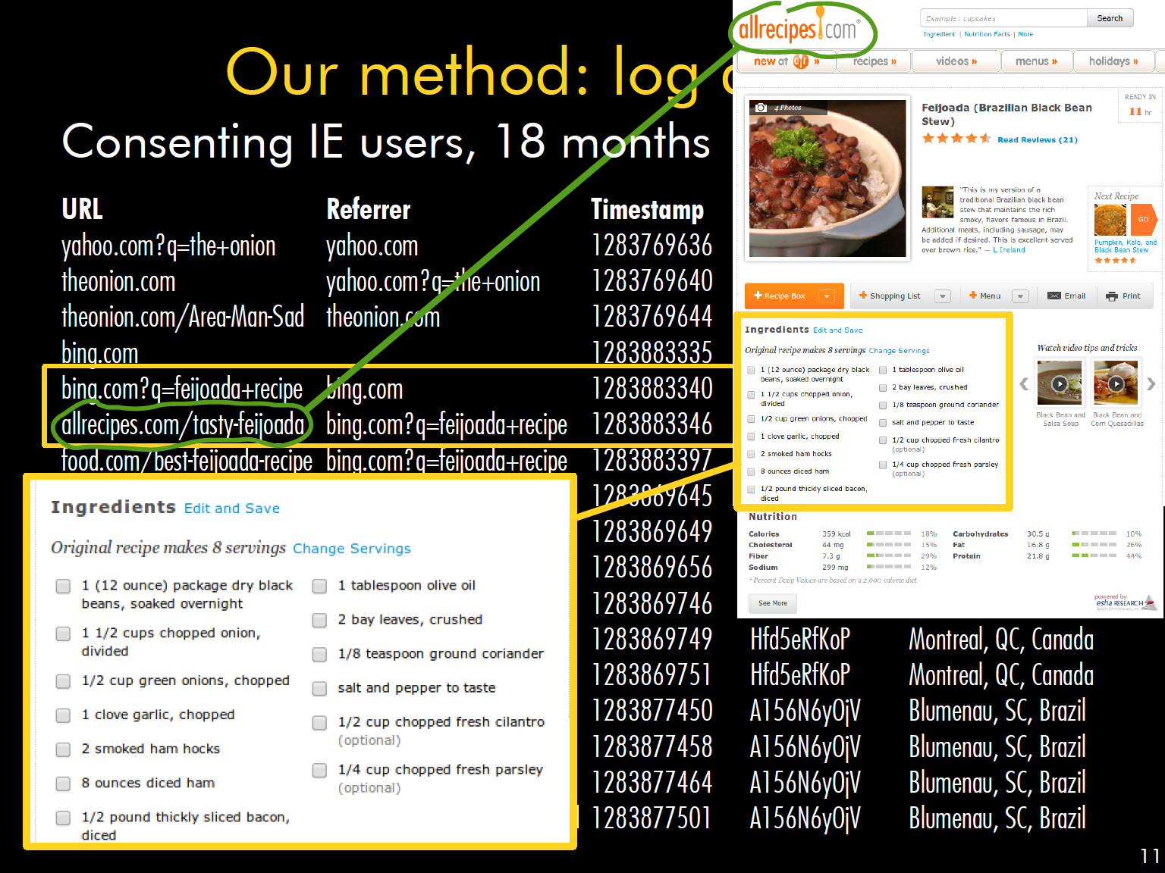

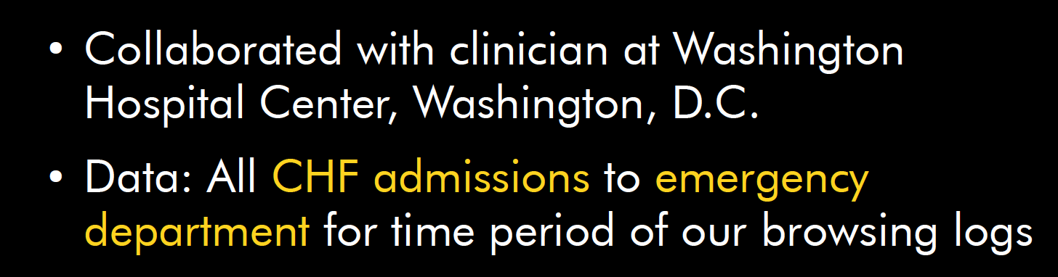
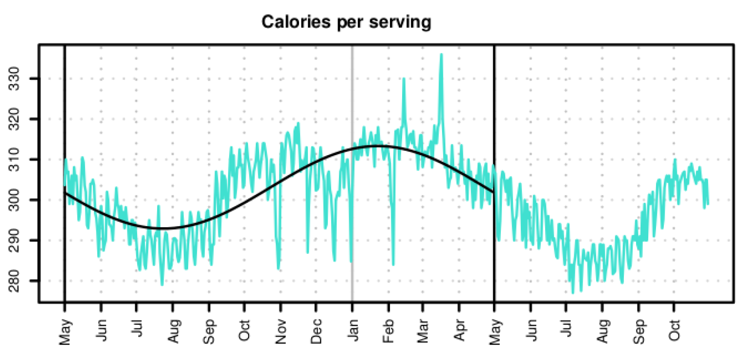
Q: What do people eat when and where?
Paper with results and plots
Slides by Dr. Robert West, Applied Data Analysis

Slide 54


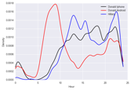
Question & Problem
Formulation
Data
Acquisition
Prediction and
Inference
Exploratory Data Analysis
Reports, Decisions, and Solutions
Exploring and Cleaning Tabular Data
Data Science in Practice EDA, Data Cleaning, Text processing (regular expressions)

Slide 55
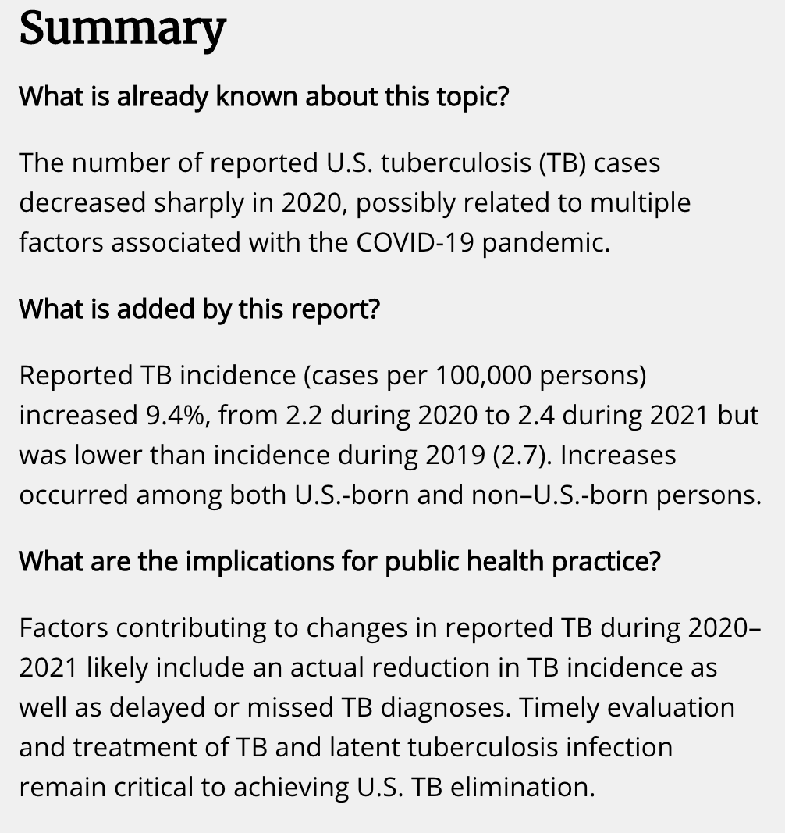

Tuberculosis – United States, 2021
CDC Morbidity and Mortality Weekly Report (MMWR) 03/25/2022.
What is incidence?
Why use it here?
How was “9.4% increase” computed?
Question: Can we reproduce these numbers using government data?
CDC: source, 2021

Slide 56
Defining incidence
From the CDC report: TB incidence is computed as the number of “cases per 100,000 persons using mid-year population estimates from the U.S. Census Bureau.”
Incidence is useful when comparing case rates across differently sized populations.
# TB cases in population
(group: 100,000 people)
TB incidence =
# groups in population
# TB cases
=
(population/100,000)
# TB cases
=
x
100,000
population
We don’t have U.S. Census population data in our DataFrame. We need to acquire it to verify incidence!

Slide 57
The Data Science Lifecycle is a Cycle
In practice, EDA informs whether you need more data to address your research question.
Question & Problem
Formulation
Data
Acquisition
Prediction and
Inference
Exploratory Data Analysis
Reports, Decisions, and Solutions

Slide 58
Structure -- the “shape” of a data file
Granularity -- how fine/coarse is each datum
Scope -- how (in)complete is the data
Temporality -- how is the data situated in time
Faithfulness -- how well does the data capture “reality”
Key Data Properties to Consider in EDA

Slide 59
Tabular Data
EDA, Part I
Structure: Tabular Data
Granularity
Structure: Variable Types
Multiple Files

Slide 60
File Format
Variable Type
Multiple files (Primary and Foreign Keys)
Structure -- the “shape” of a data file
Granularity -- how fine/coarse is each datum
Scope -- how (in)complete is the data
Temporality -- how is the data situated in time
Faithfulness -- how well does the data capture “reality”
Key Data Properties to Consider in EDA

Slide 61
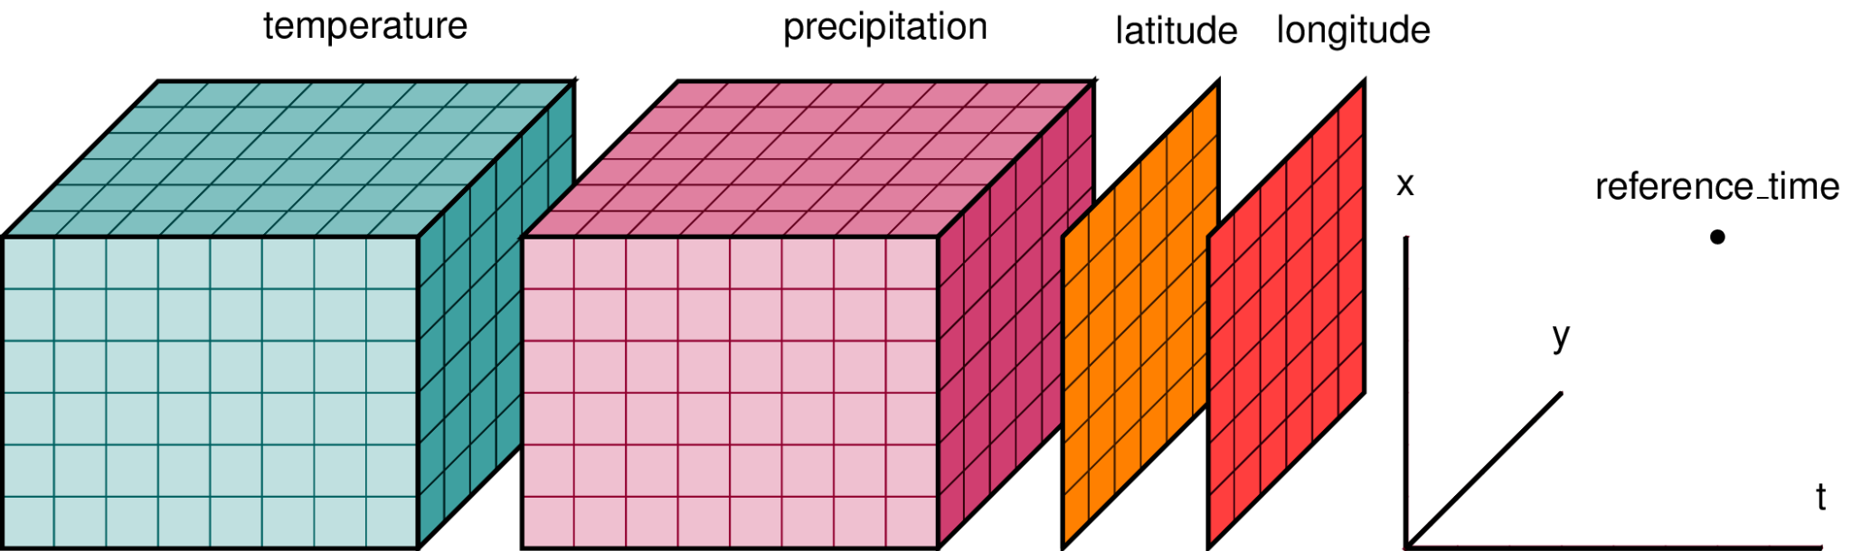
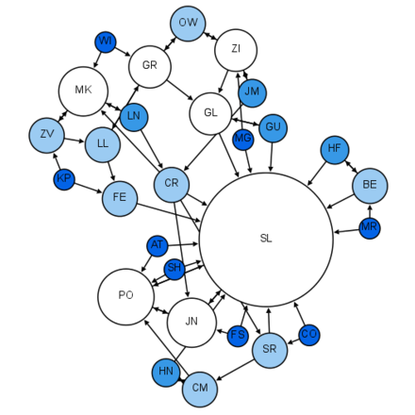

Rectangular and Non-rectangular Data
Data come in many different shapes.
Non-rectangular data
Rectangular data
Notes:
Intuitively, rectangular data are shaped like a rectangle where every value corresponds to some row and column. Most data frames store rectangular data. Non-rectangular data, on the other hand, are not neatly arranged in rows and columns.
Non-rectangular data, on the other hand, are not neatly arranged in rows and columns. Instead, they are often a culmination of separate data structures where there is some similarity among members of the same data structure. Usually non-rectangular data are stored in lists.

Slide 62
Rectangular Data
We prefer rectangular data for data analysis (why?)
Regular structures are easy to manipulate and analyze
A big part of data cleaning is about transforming data to be more rectangular
Two kinds of rectangular data: Tables and Matrices.
Fields/Attributes/ Features/Columns
Records/Rows
Tables (a.k.a. dataframes in R/Python and relations in SQL)
Named columns with different types
Manipulated using data transformation languages (map, filter, group by, join, …)
Matrices
Numeric data of the same type (float, int, etc.)
Manipulated using linear algebra

Slide 63
CSV: Comma-Separated Values
Tuberculosis in the US [CDC source].
CSV is a very common tabular file format.
Records (rows) are delimited by a newline: '\n', "\r\n"
Fields (columns) are delimited by commas: ','
Pandas: pd.read_csv(header=...)
Fields/Attributes/Features/Columns
 | U.S. jurisdiction | TB cases 2019 | …
0 | Total | 8,900 | …
1 | Alabama | 87 | …
Records/Rows

Slide 64
Granularity
EDA, Part I
Structure: Tabular Data
Granularity
Structure: Variable Types
Multiple Files

Slide 65
Granularity: How fine/coarse is each datum?
What does each record represent?
Examples: a purchase, a person, a group of users
Do all records capture granularity at the same level?
Some data will include summaries (aka rollups) as records.
If the data are coarse, how were the records aggregated?
Sampling, averaging, maybe some of both…
Rec. 1
Rec. 1
Rec. 2
Rec. 3
Rec. 1
Rec. 2
Rec. 3
Fine Grained
Coarse
Grained

Slide 66
Variable Types
EDA, Part I
Structure: Tabular Data
Granularity
Structure: Variable Types
Multiple Files

Slide 67
Variables are Columns
Let’s look at records with the same granularity.
What does each column represent?
A variable is a measurement of a particular concept.
It has two common properties:
Datatype/Storage type: How each variable value is stored in memory. df[colname].dtype
integer, floating point, boolean, object (string-like), etc.
Affects which pandas functions you use.
Variable type/Feature type: Conceptualized measurement of information (and therefore what values it can take on).
Use expert knowledge
Explore data itself
Consult data codebook (if it exists).
Affects how you visualize and interpret the data.
 | U.S. jurisdiction | TB cases 2019 | …
1 | Alabama | 87 | …
2 | Alaska | 58 | …
… | … | … | …
The U.S. Jurisdiction variable
⚠️In this class, “variable types” are conceptual!!
Notes:
Or df.info() to get a more comprehensive output
business_id business_name business_address business_city business_state business_postal_code business_latitude business_longitude business_location business_phone_number ... inspection_score inspection_type violation_id violation_description risk_category Neighborhoods SF Find Neighborhoods Current Police Districts Current Supervisor Districts Analysis Neighborhoods
0 835 Kam Po Kitchen 801 Broadway St San Francisco CA 94133 37.797223 -122.410513 POINT (-122.410513 37.797223) NaN ... 88.0 Routine - Unscheduled 835_20180917_103139 Improper food storage Low Risk 107.0 107.0 6.0 3.0 6.0
1 905 Working Girls'

Slide 68
Variable Feature Types
Variable
Many variables do not fit neatly in one of these categories!!
Intervals have meaning.
Quantitative
(numerical)
Qualitative (categorical)
Continuous
Discrete
Ordinal
Nominal
Could be measured to arbitrary precision.
Finite possible values
Categories w/ordered levels; no consistent meaning to difference
Categories w/ no
specific ordering.
Examples:
Price
Temperature
Examples:
Number of siblings
Number of classes
Examples:
Preferences
Level of education
Examples:
Political Affiliation
Cal lD number
Note that qualitative variables could have numeric levels; conversely, quantitative variables could be stored as strings!

Slide 69
Variable Types
🤔
What is the feature type (i.e., variable type) of each variable?
Variable
Quantitative
Qualitative
Q | Variable | Feature Type
1 | CO₂ level (ppm)
2 | TB cases in 2021
3 | GPA
4 | Income bracket (low, med, high)
5 | Race/Ethnicity
6 | Number of years of education
7 | Yelp Rating
Cont- inuous
Dis- crete
Ord- inal
Nom- inal
A
B
C
D
Notes:
ppm: parts per million

Slide 70
Variable Types
🤔
What is the feature type of each variable?
Variable
Quantitative
Qualitative
Q | Variable | Feature Type
1 | CO₂ level (ppm)
2 | Number of siblings
3 | GPA
4 | Income bracket (low, med, high)
5 | Race/Ethnicity
6 | Number of years of education
7 | Yelp Rating
A. Quantitative Cont.
B. Quantitative Discrete
A. Quantitative Cont.
C. Qualitative Ordinal
D. Qualitative Nominal
B. Quantitative Discrete
C. Qualitative Ordinal
Cont- inuous
Dis- crete
Ord- inal
Nom- inal
A
B
C
D
Many of these examples show how “shaggy” these categories are!!
We will revisit variable types when we learn how to visualize variables.
Notes:
(Lisa’s edit 2/1/2022 post-lecture)
There were several questions in lecture today:
Couldn’t GPA be quantitative discrete, since technically there are a finite number of possible GPAs?
Couldn’t Number of years of education be Qualitative Ordinal, since a gap of a “year” is dependent on when that year of education occurred?
Couldn’t Yelp Rating be quantitative discrete for the same reasons as GPA?
The answer to all these questions (except education, see below) is: “Yes, it could! But it depends on what question you are trying to answer with data.” We’ll see next week that many of these feature types are tied to how you’d want to visualize data. Would you want to scatterplot GPA, or do you want to lineplot GPA? How do you want to present Yelp Ratings—categorically (e.g. bar plot), or quantitatively (e.g., scatter plot)? What story are you asking from the data?
Side note on education: In my (Lisa’s) research I prefer asking education level as a Qualitative Nominal variable— high school, Undergrad, Master’s, PhD, etc.—precisely because of the above points. As data scientists working with educational data it’s highly likely that you won’t care about quantitatively comparing number of years; you probably care more about type (i.e., category) of education.

Slide 71
Multiple Files
Structure
Multiple Files
More File Formats
Scope and Temporality
Faithfulness (and Missing Values)

Slide 72
Structure: Primary Keys and Foreign Keys
Customers.csv
Sometimes your data comes in multiple files:
Often data will reference other pieces of data.
Alternatively, you will collect multiple pieces of related data.
Use pd.merge to join data on keys.
CustID | Addr
171345 | Harmon..
281139 | Main ..
Orders.csv
OrderNum | CustID | Date
1 | 171345 | 8/21/2017
2 | 281139 | 8/30/2017
Products.csv
ProdID | Cost
42 | 3.14
999 | 2.72
Purchases.csv
OrderNum | ProdID | Quantity
1 | 42 | 3
1 | 999 | 2
2 | 42 | 1

Slide 73
Structure: Primary Keys and Foreign Keys
Primary Key
Customers.csv
CustID | Addr
171345 | Harmon..
281139 | Main ..
Sometimes your data comes in multiple files:
Often data will reference other pieces of data.
Alternatively, you will collect multiple pieces of related data.
Use pd.merge to join data on keys.
Primary key: the column or set of columns in a table that uniquely determine the values in the remaining columns
Primary keys are unique, but could be tuples.
Examples: SSN, ProductIDs, …
Primary Key
Orders.csv
OrderNum | CustID | Date
1 | 171345 | 8/21/2017
2 | 281139 | 8/30/2017
Products.csv
ProdID | Cost
42 | 3.14
999 | 2.72
Primary Key
Purchases.csv
OrderNum | ProdID | Quantity
1 | 42 | 3
1 | 999 | 2
2 | 42 | 1

Slide 74
Structure: Primary Keys and Foreign Keys
Primary Key
Customers.csv
Sometimes your data comes in multiple files:
Often data will reference other pieces of data.
Alternatively, you will collect multiple pieces of related data.
Use pd.merge to join data on keys.
Primary key: the column or set of columns in a table that determine the values of the remaining columns
Primary keys are unique, but could be tuples.
Examples: SSN, ProductIDs, …
Foreign keys: the column or sets of columns that reference primary keys in other tables.
CustID | Addr
171345 | Harmon..
281139 | Main ..
Foreign Key
Orders.csv
OrderNum | CustID | Date
1 | 171345 | 8/21/2017
2 | 281139 | 8/30/2017
Products.csv
ProdID | Cost
42 | 3.14
999 | 2.72
Purchases.csv
OrderNum | ProdID | Quantity
1 | 42 | 3
1 | 999 | 2
2 | 42 | 1

Slide 75
More File Formats
Structure
Multiple Files
More File Formats
Scope and Temporality
Faithfulness (and Missing Values)

Slide 76
Are the data in a standard format or encoding?
Tabular data: CSV, TSV, Excel, SQL
Nested data: JSON or XML
Are the data organized in records or nested?
Can we define records by parsing the data?
Can we reasonably un-nest the data?
Does the data reference other data?
Can we join/merge the data?
Do we need to?
What are the fields in each record?
How are they encoded? (e.g., strings, numbers, binary, dates …)
What is the type of the data?
Structure -- the “shape” of a data file
Granularity -- how fine/coarse is each datum
Scope -- how (in)complete is the data
Temporality -- how is the data situated in time
Faithfulness -- how well does the data capture “reality”
Summary
You will do the most data wrangling when analyzing the structure of your data.

Slide 77
Scope and Temporality
Structure
Multiple Files
More File Formats
Scope and Temporality
Faithfulness (and Missing Values)

Slide 78
Scope
Will my data be enough to answer my question?
Example: I am interested in studying crime in California but I only have Berkeley crime data.
Solution: collect more data/change research question
Is my data too expansive?
Example: I am interested in student grades for DSC510 but have student grades for all Data Science classes.
Solution: Filtering ⇒ Implications on sample?
If the data is a sample I may have poor coverage after filtering (More on this next week)
Does my data cover the right time frame?
Which brings us to Temporality
“Scope” questions are defined by your question/problem and inform if you need better-scoped data.

Slide 79
Temporality
Data changes – when was the data collected/last updated?
Periodicity — Is there periodicity? Diurnal (24-hr) patterns?
What is the meaning of the time and date fields? A few options:
When the “event” happened?
When the data was collected or was entered into the system?
Date the data was copied into a database? (look for many matching timestamps)
Time depends on where! (time zones & daylight savings)
Learn to use datetime Python library and Pandas dt accessors
Regions have different datestring representations: 07/08/09?
Are there strange null values?
E.g., January 1st 1970, January 1st 1900…?
Notes:
July 8th 2009?
8th of July 2009?
2007 July 8th?

Slide 80
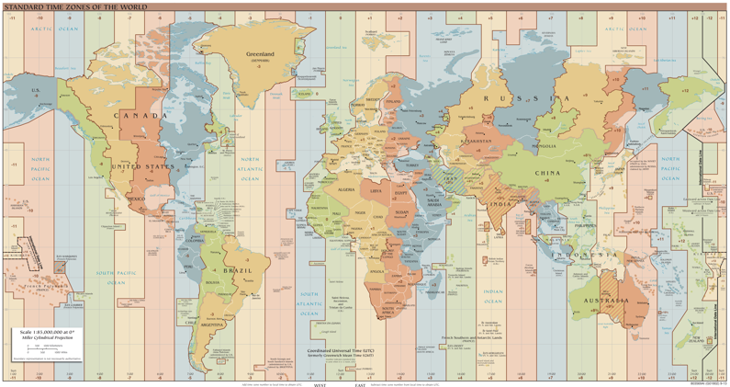
Temporality: Unix / POSIX Time
Time measured in seconds since January 1st 1970 UTC
Minus leap seconds …
UTC is Coordinated Universal Time
International time standard
Measured at 0 degrees latitude
Similar to Greenwich Mean Time (GMT)
No daylight savings
Time Zones:
San Francisco (UTC-7) with daylight savings
Jun 27, 2023 5:00pm PDT
1687910400
https://en.wikipedia.org/wiki/Coordinated_Universal_Time
Notes:
https://en.wikipedia.org/wiki/Coordinated_Universal_Time
The official abbreviation for Coordinated Universal Time is UTC. This abbreviation comes as a result of the International Telecommunication Union and the International Astronomical Union wanting to use the same abbreviation in all languages. English speakers originally proposed CUT (for "coordinated universal time"), while French speakers proposed TUC (for "temps universel coordonné"). The compromise that emerged was UTC,
Year 2038 problem 🡪 32 bit signed time wraps around.

Slide 81
Faithfulness (and Missing Values)
Structure
Multiple Files
More File Formats
Scope and Temporality
Faithfulness (and Missing Values)

Slide 82
Faithfulness: Do I trust this data?
Does my data contain unrealistic or “incorrect” values?
Dates in the future for events in the past
Locations that don’t exist
Negative counts
Misspellings of names
Large outliers
Does my data violate obvious dependencies?
E.g., age and birthday don’t match
Was the data entered by hand?
Spelling errors, fields shifted …
Did the form require all fields or provide default values?
Are there obvious signs of data falsification?
Repeated names, fake looking email addresses, repeated use of uncommon names or fields.

Slide 83
Signs that your data may not be faithful (and proposed solutions)
Truncated data Early Microsoft Excel limits: 65536 Rows, 255 Columns
Duplicated Records or Fields
Identify and eliminate (use primary key).
Be aware of consequences in analysis when using data with inconsistencies.
Understand the potential implications for how data were collected.
Spelling Errors
Apply corrections or drop records not in a dictionary
Units not specified or consistent
Infer units, check values are in reasonable ranges for data
Missing Data???
Examples
" “
0, -1 999, 12345
1970, 1900
NaN
Null
Time Zone Inconsistencies
Convert to a common timezone (e.g., UTC)
NaN: “Not a Number”

Slide 84
Missing Data/Default Values: Solutions
A. Drop records with missing values
Probably most common
Caution: check for biases induced by dropped values
Missing or corrupt records might be related to something of interest
B. Keep as NaN
C. Imputation/Interpolation: Inferring missing values
Average Imputation: replace with an average value
Which average? Often use closest related subgroup mean.
Hot deck imputation: replace with a random value
Regression imputation: replace with a predicted value, using some model
Multiple imputation: replace with multiple random values.

Slide 85
Missing Data/Default Values: Solutions
A. Drop records with missing values
Probably most common
Caution: check for biases induced by dropped values
Missing or corrupt records might be related to something of interest
B. Keep as NaN
C. Imputation/Interpolation: Inferring missing values
Average Imputation: replace with an average value
Which average? Often use closest related subgroup mean.
Hot deck imputation: replace with a random value
Regression imputation: replace with a predicted value, using some model
Multiple imputation: replace with multiple random values.
Choice affects bias and uncertainty quantification (large statistics literature)
Essential question: why are the records missing?
(beyond this course)

Slide 86
Summary: How do you do EDA/Data Wrangling?
Examine data and metadata:
What is the date, size, organization, and structure of the data?
Examine each field/attribute/dimension individually
Examine pairs of related dimensions
Stratifying earlier analysis: break down grades by major …
Along the way:
Visualize/summarize the data
Validate assumptions about data and collection process. Pay particular attention to when data were collected.
Identify and address anomalies
Apply data transformations and corrections
Record everything you do! (why?)
Developing in Jupyter Notebooks promotes reproducibility of your own work.

